Slide 1
Part 3
Graphics development for mobile systems

Slide 2
Mobile Graphics
Heterogeneity
OS
programming
languages
architecture
3D APIs
IDEs
Notes:
Mobile development is nowadays very heterogeneous. There are many architectures, OS, Prog. Lang., 3D APIs, dev. Environments…

Slide 3
Mobile Graphics
Heterogeneity
OS
programming
languages
IDEs
3D APIs
Notes:
The objective of this presentation is to unwrap the complexity and try to provide a brief overview on the available options and solutions in order to develop with minimal pain.

Slide 4
Mobile Graphics
Android
iOS
Windows Phone
Firefox OS, Ubuntu Phone, Tizen…
OS
Programming Languages
Architectures
3D APIs
Cross-development
C++
Obj-C / Swift
Java
C# / Silverlight
Html5/JS/CSS
X86 (x86_64): Intel / AMD
ARM (32/64bit): ARM + (Qualcomm, Samsung, Apple, NVIDIA,…)
MIPS (32/64 bit): Ingenics, Imagination.
OpenGL / GL ES
D3D / ANGLE
Metal / Mantle / Vulkan (GL Next)
Qt
Marmalade / Xamarin /
Muio
Monogame / Shiva3D / Unity / UDK4 / Cocos2d-x
Notes:
This will be the roadmap, which I will skip since it will remain mainly for quick reference.

Slide 5
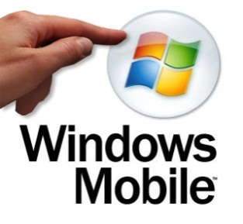
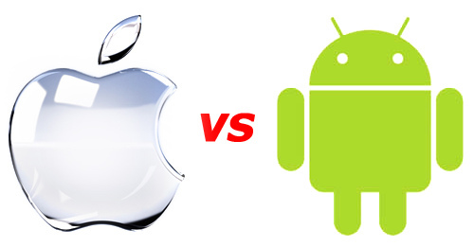
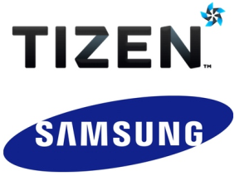
Operating Systems

Slide 6
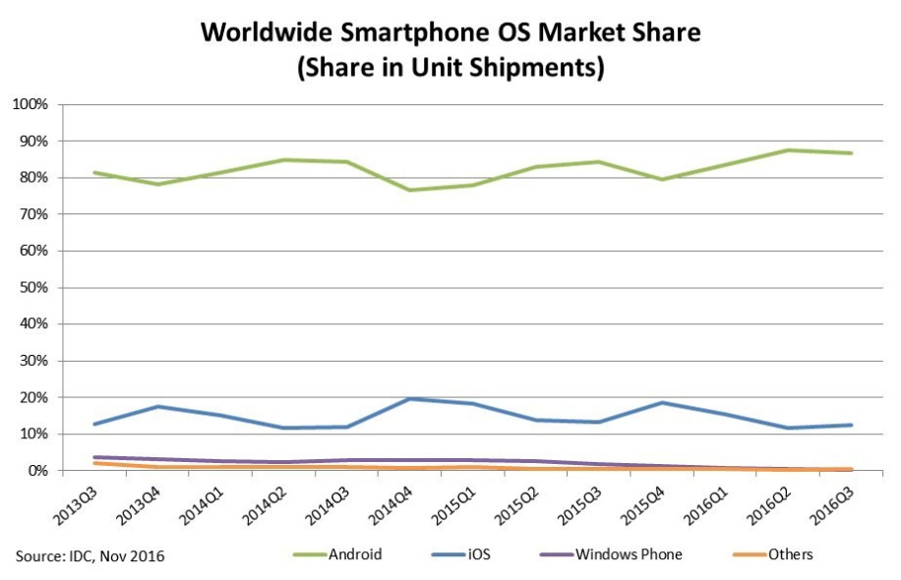
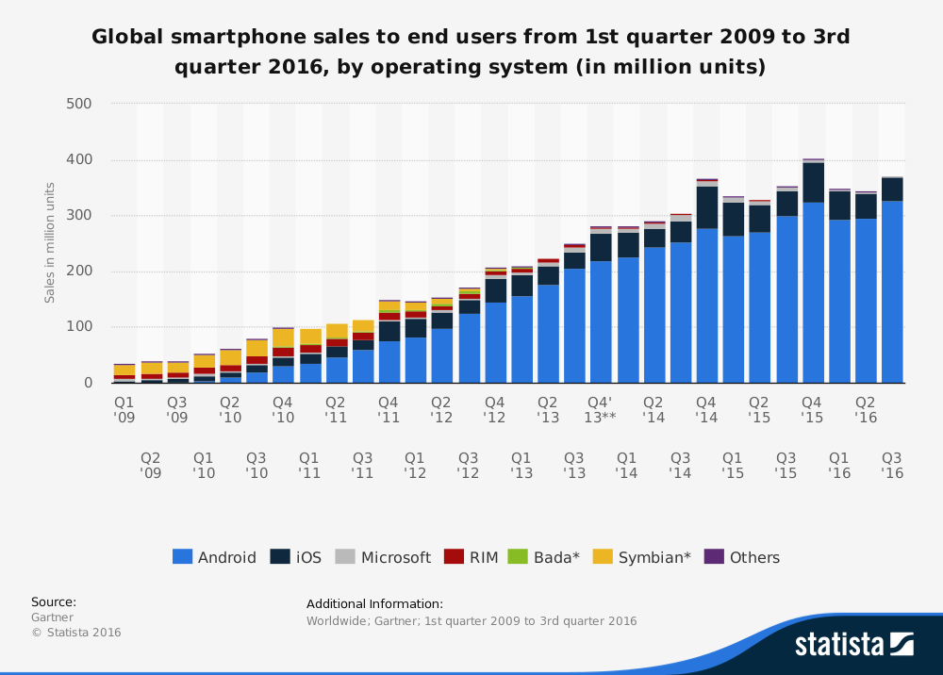
Operating Systems
Linux based (Qt…)
Ubuntu, Tizen, BBOS…
Web based (Cloud OS)
ChromeOS, FirefoxOS, WebOS
Windows Phone
iOS (~unix + COCOA)
Android (JAVA VM)
Notes:
Most part linux based (Except Windows Phone)
Some HTML5 framework (as OS API) – web based
Some Qt framework – Ubuntu Phone
IOS – unix based COCOA framework
Android – Java Virtual Machine

Slide 7
Development trends
Hard to follow the trends
software does not follow hardware evolution
strong market oriented field where finance has strong impact on evolution
In general, for
Mobile phones
Market drive towards Android, iOS
Tablets
Android, iOS, Windows 10
Embedded devices
Heterogenous (beyond the scopes of this course)
Here we focus on mobile phones and tablets

Slide 8
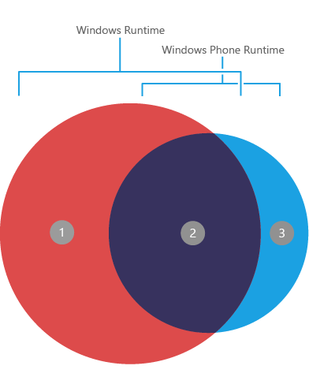
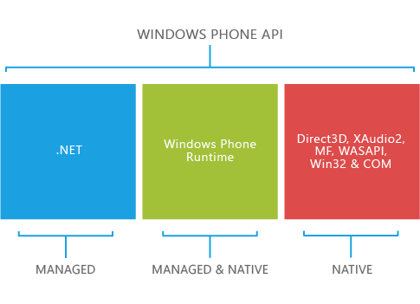
Operating Systems
Windows 10
Windows development – Visual Studio 2017
Good debugging / compiler / integration
Great integration and deployment
Universal Windows Platform (UWP)
API access
C#, VB.NET, and C++
3D API
D3D
OpenGL access through ANGLE
Advantages
Visual Studio, interoperability with iOS
HW is quite selected/homogeneous
Disadvantages
~OpenGL wrapper just recently!

Slide 9
Operating Systems
iOS
Development under MacOS
Xcode – good IDE/debug
Clang compiler!
API access
Objective-C, swift
Library programming
C++ support
Advantages:
Homogeneous hardware (biggest issues are resolution related)
State-of-the-art CPU/GPU (PowerVR SGX 54X/554, G6400)
Good dev tools (Xcode + Clang)
Inconvenients:
Closed platform
Requires iDevice for development/shipment (mostly)

Slide 10
Operating Systems
Android
Development in Eclipse / AndroidStudio
Java-based – integrated debugging (non-trivial for NDK)
GCC / clang compilers
Advantages
Wide variety of hardware configurations (CPU/GPU)
Java based + C++ as dynamic library (JNI or NDK+NativeActivity)
Open source
Toolchain provided for Windows/Linux/MacOS (GCC + Clang)
Faster access to new hardware / functionality!
Inconvenients
Heterogeneous device base (hard to target all configurations)
Not so integrated IDE -- ~mixed pieces

Slide 11
Operating Systems (comparison)
App development -- publishing
WinPhone & iOS requires less effort for distribution
Easy to reach the whole user base
Android has a wide variety of configuration that require tuning
User base is typically reached in an incremental way (supporting more configs)
Many HW configurations (CPU/GPU) give more options to explore ☺
Windows has not yet the same market share
Variety of configurations

Slide 12
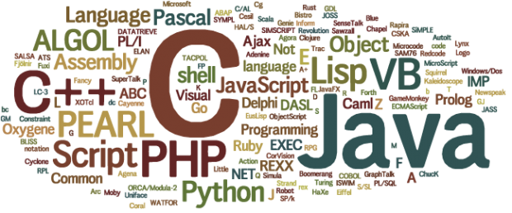
Programming Languages
http://www.tops-int.com/blog/which-programming-languages-are-used-for-web-desktop-and-mobile-apps/

Slide 13
Programming Languages
C/C++
Classic, performance, codebase, control
Objective C
Bit different style (message based), well-documented API for iOS, mainly COCOA/iOS
Java
Android is VM/JIT based, ~portability (API), well-known, extended, codebase
C#
VM based, ~Java evolution, (Win, Android, iOS)
Swift
Apple new language, simplicity, performance, easy, LLVM-based compilers
HTML5/JS
Web technologies, extended, compatibility
Perl, Python, Ruby, D, GO (Google), Hack (facebook), …
More options, not so popular ?
Notes:
WinPhone -

Slide 14
3D APIs

Slide 15
3D APIs
OpenGL Next
5.0
Mantle
Direct3D
Metal

Slide 16
3D APIs
Direct 3D
3D API from MS for Win OS (XBOX)
ANGLE library provides GL support on top of D3D
Mantle
AMD 3D API with Low-level access → D3D12 | GL_NG
Metal
Apple 3D API with low-level access
OpenGL Desktop/ES/WebGL
GL for embedded systems, now in version 3.2
GLES3.2 ~ GL4.5
GL Next Generation → Vulkan
redesign to unify OpenGL and OpenGL ES into one common API (no backward compatibility)

Slide 17
3D APIs
Direct 3D
Games on Windows (mostly) / XBOX
Define 3D functionality state-of-the-art
OpenGL typically following
3D graphic cards highly collaborative
Multithread programming
Proprietary – closed source – M$
Tested & stable – good support + tools
Metal
Apple 3D API with low-level access
Much in the way of Mantle?
buffer & image, command buffers, sync…
Lean & mean → simple + ~flexible
Win &
Game research
Mac/iOS future ?

Slide 18
3D APIs
Mantle
AMD effort – low level – direct access – 3D API
Direct control of memory (CPU/GPU) – multithreading done well
User-required synchronization
API calls per frame <3k → 100K
Resources: buffer & image ☺
Simplified driver → maintenance (vendors)
High level API/Framework/Engines will be developed ☺
Pipeline state
shaders + targets (depth/color…) + resources + geometry
Command queues + synchronization
Compute / Draw / DMA(mem. Copy)
Bindless – shaders can refer to state resources
OpenGL NEXT seems to move into ‘Mantle direction’
Direct 3D 12 already pursuing low-level access
Notes:
http://techreport.com/review/25683/delving-deeper-into-amd-mantle-api

Slide 19
3D APIs
OpenGL (Desktop/ES/WebGL)
Open / research / cross-platform
Lagging in front of D3D → Legacy support ☹
No more FIXED PIPELINE (1992)!! -- scientific visualization…
GLSL (2003)…GL 3.1(2009) → deprecation/no fixed pipeline
Compatibility profile → legacy again…(till GL 4)
Core profile
GLSL → shader required
VAO
group of VBO
we need a base VAO for using VBO!
Simplifying → VBO + GLSL only!

Slide 20
3D APIs
OpenGL ES 1.1
Fixed pipeline – no glBegin/End – no GL_POLYGON -- VBO
OpenGL ES 2 (OpenGL 1.5 + GLSL) ~ GL4.1
No fixed pipeline (shaders mandatory), ETC1 texture compress..
OpenGL ES 3 ~ GL4.3
Occlusion queries + geometry instancing
32bit integer/float in GLSL
Core 3D textures, depth textures, ETC2/EAC, many formats…
Uniform Buffer Objects (packed shader parameters)
OpenGL ES 3.2 ~ GL4.5
Compute shaders (atomics, load/store)
Separate shader objects (reuse)
Indirect draw (shader culling…)
NO geometry/tessellation

Slide 21
3D APIs
Vulkan
derived from and built upon components of AMD's Mantle API
with respect to OpenGL
lower level API
more balanced CPU/GPU usage
parallel tasking
work distribution across multiple CPU cores
OpenGL | Vulkan
Global state machine | No global state
State tied to context | Comman buffer instead of state
Sequential operations | Multithreaded programming
Limited control of GPU memory and sync | Explicit control of memory man. and sync
Extensive error checking | No error checking at runtime

Slide 22
3D APIs
GPGPU
OpenCL
On Android it is not much loved
Use GPU vendor SDK provided libs ☺
On iOS is only accepted for system apps
Use old-school GPGPU (fragment shader -> FrameBuffer)
Compute shaders
GLES 3.2!!! General solution!!
DirectCompute on D3D

Slide 23
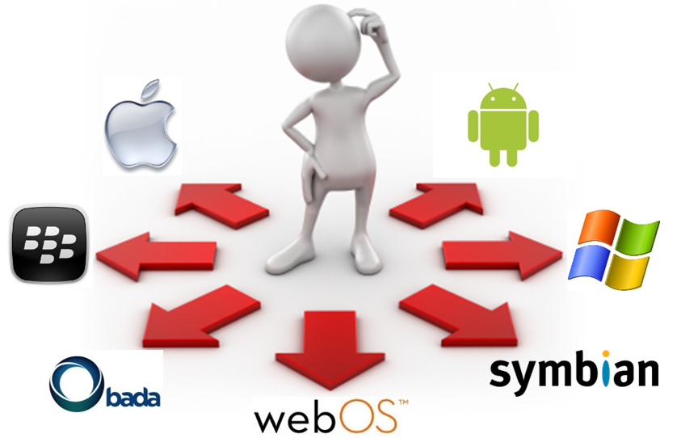
Cross-development
http://www.appian.com/blog/enterprise-mobility-2/are-mobile-platform-choices-limiting-enterprise-process-innovation

Slide 24
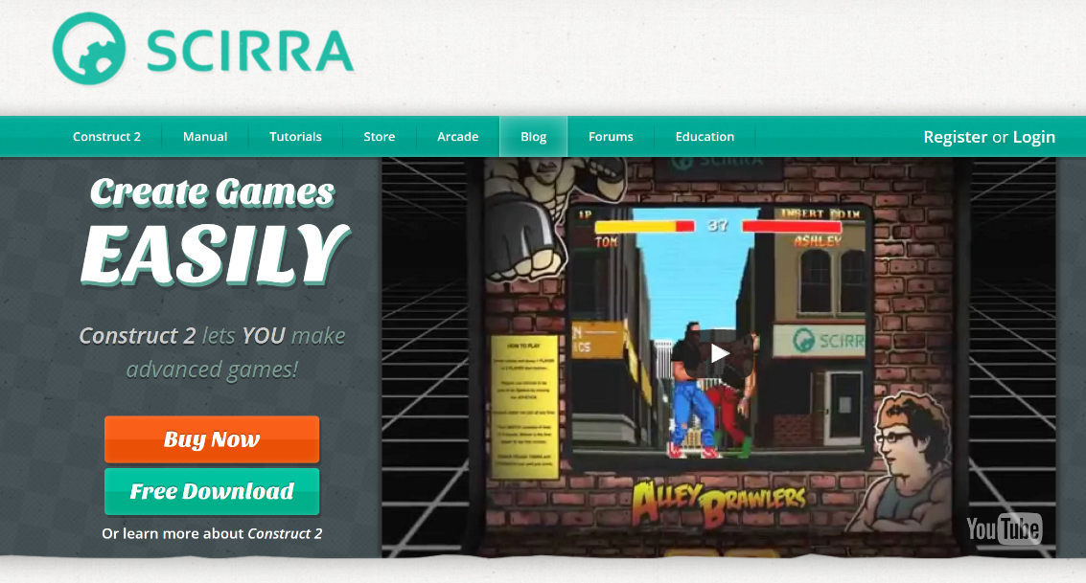
Easy solutions...
Code-less development
Scirra Construct2
“Photoshop for games”
HTML-5 games editor
Yoyo GameMaker Studio 2
Drag’n Drop environment

Slide 25
Cross platform
Unity Mobile (for gaming and VR)
iOS/Android, integration with Tango
Unreal Engine 4 (for gaming and VR)
iOS/Android
former Unreal Development Kit
free usage, payment only for shipping
Corona SDK
iOS /Android
uses integrated Lua layered on top of C++/OpenGL to build graphic application
audio and graphics, cryptography, networking, device information and user input

Slide 26
Cross platform
Marmalade
iOS/Android/Windows
two main layers
low level C API for memory management, file access, timers, networking, input methods (e.g. accelerometer, keyboard, touch screen) and sound and video output.
C++ API for higher level functionality for 2D (e.g. bitmap handling, fonts) 3D graphics rendering (e.g. 3D mesh rendering, boned animation), resource management system and HTTP networking.
Very successful but dismissing by March 2017
EdgeLib
iOS/Android/Windows
high performance graphics engine in C++
support for 2D graphics, 3D graphics (OpenGL ES), input and sound

Slide 27
Cross platform
JMonkey Engine
Android
written in Java and using shader technology extensively
uses LWJGL as its default renderer (another renderer based on JOGL is available, supporting OpenGL 4)
PowerVR
iOS/Android/Windows
a cross-platform OS and API abstraction layer, a library of helper tools for maths and resource loading
optimized for PowerVR GPUs, with Vulkan support
ARM Developer Center
Plenty of tools (computer vision and machine learning, OpenGL ES emulator, texture compression)

Slide 28
Cross-development
C++ use case: QtCreator
Qt (~supports android, iOS, windows phone, linux, windows, mac)
Provides API abstraction for UI, in-app purchases, ~touch input
HOWTO (i.e. android):
Android SDK
Android NDK (native C++ support, toolchain, libraries, GL, CL…)
Point environment variables ANDROID_SDK, ANDROID_NDK to folders
Create new android project
Play!
Notes:
Go for Qt > 5.4 (touch events were tricky in previous versions)
Use QOpenGLWidget instead of QGLWidget
Enable touch events on each widget:
QWidget::setAttribute(Qt::WA_AcceptTouchEvents);

Slide 29
Mobile Graphics – Development
Conclusions
1) Native + platform UI …
C++ [any language] → LLVM compiler → target platform
Platform Framework front-end → 1 for each platform
Performance + flexibility
Call native code from platform code (JNI, Object C, …)
2) Native through framework …
Qt | Marmalade …
C++ code uses framework API
Framework API abstracts platform API [N platforms]
BUT less flexible integration ?
3) Go web → HTML5/JS …
JS code + WebGL
~Free portability (chrome / firefox / IE … ?)
BUT performance is 0.5X at most with asm.js

Slide 30
MOBILE METRIC CAPTURE AND RECONSTRUCTION
Next Session

