Slide 1
DAG Construction
Erik Sintorn
Chalmers University of Technology, Sweden
Notes:
Welcome back
Before the break, we went through the theory.
These next two talks will be on more practical things.
I will start by talking about how we actually build these DAGs on GPUs, using parallel primitives.

Slide 2
Outline
Content
  Voxelization and building an SVO
  Efficient SVO to DAG compression, first version
  Efficient SVO to DAG compression, second version
Notes:
So, the outline of the talk is that:
I will first talk briefly about voxelization
And then about how to create an SVO from the voxelization
Then I will explain how we used to build a DAG from the SVO
And then I will go through an alternative way of doing this, which is quite a lot simpler and faster.

Slide 3
Parallel primitives in CUDA
Our GPU Implementation is based on standard parallel primitives
  Stream Compaction
  Sorting
  Prefix Sum
A number of libraries exist for doing these things
  THRUST (http://docs.nvidia.com/cuda/thrust/index.html)
  CUDPP (http://cudpp.github.io/)
  CUB (https://nvlabs.github.io/cub/)
Notes:
Before I start though,
I will talk a lot about these parallel primitives.
These are things like: sorting an array, stream compaction and prefix sum.
Stuff that must be fast, and that you do not want to write yourself.
There are a number of libraries available for this:
THRUST actually ships with CUDA, but the last time I tried it it performed very badly,
So I now use CUB.
Either of these libraries should work though.

Slide 4
Voxelization
Render geometry to voxel-grid sized rendertarget
  Render triangles from X, Y or Z axis that gives largest area
    Single pass, choose axis in geometry shader
  Avoid cracks with GL_NV_conservative_raster
  Output long list of fragments as Morton order integers
  Simple tutorial at https://developer.nvidia.com/content/basics-gpu-voxelization
Notes:
The first step is to voxelize our scene.
We do this in a single renderpass, with a viewport set up to match the resolution of the final DAG.
For each triangle we choose to project it as seen from the X, Y or Z axis, depending on which gives the largest area.
Also, to avoid cracks, we need to use some sort of conservative rasterization.
This is pretty easy these days, with the GL_NV_conservative_raster OpenGL extension.
In the fragment shader, we will simply turn the fragments position into the grid coordinates, and output it to a long list as a Morton code.
There are many tutorials on voxelization on the internet, and here’s a link for one of them.

Slide 5



Build SVO in CUDA
Given the Morton cords, $v_{i}$, of all set voxels
  Parent coord is ${(v}_{i}≫3)$
  Child index is ${(v}_{i}\&7)$
parent coord
$$v_{i}=$$
$x_{N}y_{N}z_{N}$…$x_{1}y_{1}z_{1}x_{0}y_{0}z_{0}$
child index
Notes:
We output the voxel’s position as a Morton code, because that makes it very easy mask of the three lowest bits and
<click>
Then the upper bits are the coordinates of the leaf node,
And the lower bits are the index of the voxel within its parent.

Slide 6
Build SVO in CUDA (leaf level)
Sort all voxels (and remove identical)
001010|001
001010|010
001010|011
001011|001
001011|100
001100|100
Notes:
Now we have a long list of voxels, and we want to build an SVO.
We start by sorting the list, and removing all identical nodes.
This is stuff that a library will handle efficiently for us.

Slide 7
Build SVO in CUDA (leaf level)
Sort all voxels (and remove identical)
Mark first child of all parents
001010|001
001010|010
001010|011
001011|001
001011|100
010100|100
1
0
0
1
0
1
Notes:
Then, we mark the first voxel of each leafnode. We do this by running through all the voxels, and checking the voxel to the left.
If it has the same parent: We write a zero.
If it has a different parent, this is the first child, so we write a one.

Slide 8
Build SVO in CUDA (leaf level)
Sort all voxels (and remove identical)
Mark first child of all parents
Prefix sum gives position of parents
001010|001
001010|010
001010|011
001011|001
001011|100
010100|100
1
0
0
1
0
1
0
0
0
1
1
2
Notes:
We can then do a prefix sum on this list, which will give us, for every voxel, the index of its parent.

Slide 9
Build SVO in CUDA (leaf level)
Sort all voxels (and remove identical)
Mark first child of all parents
Prefix sum gives position of parents
Build leaf level cords and childmasks
001010|001
001010|010
001010|011
001011|001
001011|100
010100|100
1
0
0
1
0
1
0
0
0
1
1
2
001010
001011
010100
00001110
00010010
00010000
Notes:
Now we can build the leaf level of our SVO.
<click>
We first build a list of all the leaf level coordinates, that we will use to continue building the tree
We do this by running through all the voxels,
finding the position of the leaf node it ended up in,
and writing down the parent coord at that location
<click>
Then we build the actual leaf level of the SVO, that is, the childmasks of all the leafs.
We mask out the index of the voxel in the leaf node,
look up the position of the leaf node
and set the right bit in the corresponding child-mask

Slide 10
Build SVO in CUDA (internal levels)
Start from coords in last pass
Mark first child of all parents
Prefix sum gives position of parents
Build next level cords childmasks and pointer
001|010
001|011
010|100
1
0
1
0
0
1
001
010
00001100|0
00010000|2
Notes:
Now we have the leaf level of the SVO, and we need to build all of the internal nodes.
We do this in almost exactly the same way.
So, we start from the leaf coordinates we created in the last pass,
Mark the first child of all parents
Prefix sum that list to get the position of the parents.

Slide 11
Creating a DAG from an SVO
1111
001
0110
005
1101
007
1111
010
0110
014
Notes:
This dag is the ‘S’
For brevity, let’s say each node takes one word

Slide 12
Creating a DAG from an SVO
Level:
0
1111
001
1
0110
005
1101
007
1111
010
0110
014
2
Notes:
Ta make this easier, let’s visualize the words divided into levels

Slide 13
Creating a DAG from an SVO
Level:
0
1111
000|001|002|003
1
0110
- |000|001| -
1101
002|003| - |004
1111
005|006|007|008
0110
- |009|010| -
2
Notes:
Then, the first step is to expand nodes so they have eight pointers (one per possible child)
While building, we store null pointers for non-existing children, so the nodes are easily indexable
Also, we write the indexes as offsets into each level

Slide 14
Creating a DAG from an SVO
Level:
0
1111
000|001|002|003
1
0110
- |000|001| -
1101
002|003| - |004
1111
005|006|007|008
0110
- |009|010| -
2
original idx:
0
1
2
3
4
5
6
7
8
9
10
Notes:
Now we create a list with the index of each node in the leaf level

Slide 15
Creating a DAG from an SVO
Level:
0
1111
000|001|002|003
1
0110
- |000|001| -
1101
002|003| - |004
1111
005|006|007|008
0110
- |009|010| -
2
original idx:
0
9
1
10
2
8
3
4
6
5
7
Notes:
We then sort that list, and the leaf nodes, based on the child masks in the leaf nodes.
The sorted list of numbers tells us where each node was before sorting.

Slide 16
Creating a DAG from an SVO
Level:
0
1111
000|001|002|003
1
0110
- |000|001| -
1101
002|003| - |004
1111
005|006|007|008
0110
- |009|010| -
2
original idx:
0
9
1
10
2
8
3
4
6
5
7
sorted idx:
0
2
4
6
7
9
8
10
5
1
3
Notes:
We now create the inverse of that list so we can look up where each node ended up after sorting

Slide 17
Creating a DAG from an SVO
Level:
0
1111
000|001|002|003
1
0110
- |000|001| -
1101
002|003| - |004
1111
005|006|007|008
0110
- |009|010| -
2
original idx:
0
9
1
10
2
8
3
4
6
5
7
sorted idx:
0
2
4
6
7
9
8
10
5
1
3
first unique:
1
0
1
0
1
0
1
0
0
1
1
Notes:
Next we run through all the leaf nodes again, and write a “1” if it is the first of its kind, and zero otherwise

Slide 18
Creating a DAG from an SVO
Level:
0
1111
000|001|002|003
1
0110
- |000|001| -
1101
002|003| - |004
1111
005|006|007|008
0110
- |009|010| -
2
original idx:
0
9
1
10
2
8
3
4
6
5
7
sorted idx:
0
2
4
6
7
9
8
10
5
1
3
first unique:
1
0
1
0
1
0
1
0
0
1
1
compact idx:
0
0
1
1
2
2
3
3
3
4
5
Notes:
Then we calculate the prefix sum of this new array to get, for each leaf node, where the new index it should have within the leaf level

Slide 19
Creating a DAG from an SVO
Level:
0
1111
000|001|002|003
1
0110
- |000|001| -
1101
002|003| - |004
1111
005|006|007|008
0110
- |009|010| -
2
original idx:
0
9
1
10
2
8
3
4
6
5
7
sorted idx:
0
2
4
6
7
9
8
10
5
1
3
first unique:
1
0
1
0
1
0
1
0
0
1
1
compact idx:
0
0
1
1
2
2
3
3
3
4
5
Notes:
We run a stream compaction pass on the leaf nodes, to keep only the unique nodes

Slide 20
Creating a DAG from an SVO
Level:
0
1111
000|001|002|003
1
005|006|007|008
- |009|010| -
0110
- |000|001| -
1101
002|003| - |004
1111
0110
- |000|010| -
2
original idx:
0
9
1
10
2
8
3
4
6
5
7
sorted idx:
0
2
4
6
7
9
8
10
5
1
3
first unique:
1
0
1
0
1
0
1
0
0
1
1
compact idx:
0
0
1
1
2
2
3
3
3
4
5
Notes:
Finally, we run through all the parent pointers
<click>
We use the previous index to look up the index of the same node in the sorted list
<click>
We use that index to find the offset in the compact list
<click>
And so we update the pointer with that index

Slide 21
Creating a DAG from an SVO
Level:
0
1111
000|001|002|003
1
0110
- |000|001| -
1101
002|000| - |000
1111
004|000|005|002
0110
- |000|001| -
2
Notes:
Now that we have reduced the leaf level, we can do excactly the same thing to level 1.

Slide 22
Creating a DAG from an SVO
Level:
0
1111
000|001|002|003
1
0110
- |000|001| -
1101
002|000| - |000
1111
004|000|005|002
0110
- |000|001| -
0
1
2
3
2
Notes:
So we generate a list of indices

Slide 23
Creating a DAG from an SVO
Level:
0
1111
000|001|002|003
1
0110
- |000|001| -
0110
- |000|001| -
1101
002|000| - |000
1111
004|000|005|002
0
3
1
2
2
Notes:
We sort the nodes. Note that this time we use ALL THE POINTERS as our sorting key.

Slide 24
Creating a DAG from an SVO
Level:
0
1111
000|001|002|003
1
0110
- |000|001| -
0110
- |000|001| -
1101
002|000| - |000
1111
004|000|005|002
0
3
1
2
0
2
3
1
1
0
1
1
0
0
1
2
2
Notes:
We generate the new index list, identify unique nodes and calculate the index in the compact list

Slide 25
Creating a DAG from an SVO
Level:
0
1111
000|001|002|001
1
0110
- |000|001| -
1101
002|000| - |000
1111
004|000|005|002
2
Notes:
Then we stream compact the nodes in level 1 and update the pointers in level 0.
In a larger SVO we would keep doing this for all levels.
When we are done, we still have a DAG with lots of NULL pointers, and the levels do not lie in a compact array.

Slide 26
Creating a DAG from an SVO
Level:
0
1111
000|001|002|001
5 words
1
0110
- |000|001| -
1101
002|000| - |000
1111
004|000|005|002
3 words
4 words
5 words
2
1 word
1 word
1 word
1 word
1 word
1 word
Notes:
So the final step is to run through all the nodes and calculate their final size

Slide 27
Creating a DAG from an SVO
Level:
0
1111
000|001|002|001
0
1
0110
- |000|001| -
1101
002|000| - |000
1111
004|000|005|002
5
8
12
2
17
18
19
20
21
22
Notes:
Run a prefix sum on this array to find the final index

Slide 28
Creating a DAG from an SVO
Level:
0
1111
005|008|012|005
0
1
0110
- |017|018| -
1101
019|017| - |017
1111
021|017|021|019
5
8
12
2
17
18
19
20
21
22
Notes:
Update the pointers to the new indices

Slide 29
Creating a DAG from an SVO
1111
005|008|012|005
0110
017|018
1101
019|017|017
1111
021|017|021|019
Issues:
Using eight int32 numbers as a sorting key is expensive
Since we start from the bottom of the SVO, the processing time
will be dependent on the size of the leaf level
Notes:
And copy the nodes to their new indices in a compact array.
This algorithm works, and is really quite fast if implemented with cudpp/cub/thrust on the GPU.
But there are two annoying problems with it.

Slide 30
Creating a DAG from an SVO,
Alternative Version
Notes:
While writing a TVCG extension to our I3D paper on fast construction of precomputed voxelized shadows, we came up with a much simpler and faster method.
Let’s say our original SVO looks like this.
We start at level 2, and calculate a hash value for each node, based on the child-masks of its contained leaf nodes. <click>

Slide 31








Creating a DAG from an SVO,
Alternative Version
$$\#_{1}$$
$$\#_{2}$$
$$\#_{3}$$
$$\#_{1}$$
$$\#_{1}$$
$$\#_{2}$$
$$\#_{3}$$
$$\#_{1}$$
Notes:
This is already interesting. Since the has value only depends on the childmasks, we can immediately see which subtrees are identical.
So, without ever having sorted the leaf level, we could remove the redundant nodes in level 1.

Slide 32



Creating a DAG from an SVO,
Alternative Version
$$\#_{5}$$
$$\#_{4}$$
$$\#_{4}$$
$$\#_{1}$$
$$\#_{2}$$
$$\#_{3}$$
$$\#_{1}$$
$$\#_{1}$$
$$\#_{2}$$
$$\#_{3}$$
$$\#_{1}$$
Notes:
We contine to create hash values for the upper levels, always creating the hash based on the hashes of the child-nodes.
Now we can remove common sub trees with a top-down algorithm instead.
Starting at level 1, we sort the nodes, based on their hash, remove redundant nodes and update the parent pointers.

Slide 33






Creating a DAG from an SVO,
Alternative Version
$$\#_{5}$$
$$\#_{4}$$
$$\#_{1}$$
$$\#_{2}$$
$$\#_{3}$$
$$\#_{1}$$
Notes:
Now we move on to level 2, which is a lot smaller than it was before,
sort that level, remove redundant nodes and update parent pointers…

Slide 34





Creating a DAG from an SVO,
Alternative Version
$$\#_{5}$$
$$\#_{4}$$
$$\#_{1}$$
$$\#_{2}$$
$$\#_{3}$$
Notes:
That reduced the size of the leaf level, which we finally sort and reduce.

Slide 35





Creating a DAG from an SVO,
Alternative Version
$$\#_{5}$$
$$\#_{4}$$
$$\#_{1}$$
$$\#_{2}$$
$$\#_{3}$$
Notes:
This algorithm can be much faster (was about 2x as fast in our shadow tests).
Processing time will be proportional to the largest level in the DAG rather than in the SVO so it should scale much better.
Also, we always sort on the hash value, rather than the pointers, which is much better.
There is a theoretical possibility that hash values could collide, which would cause very weird result, but this risk goes towards zero as we increase the size of the hash value.
For us, 64 bits was sufficient to never experience any collisions.

Slide 36
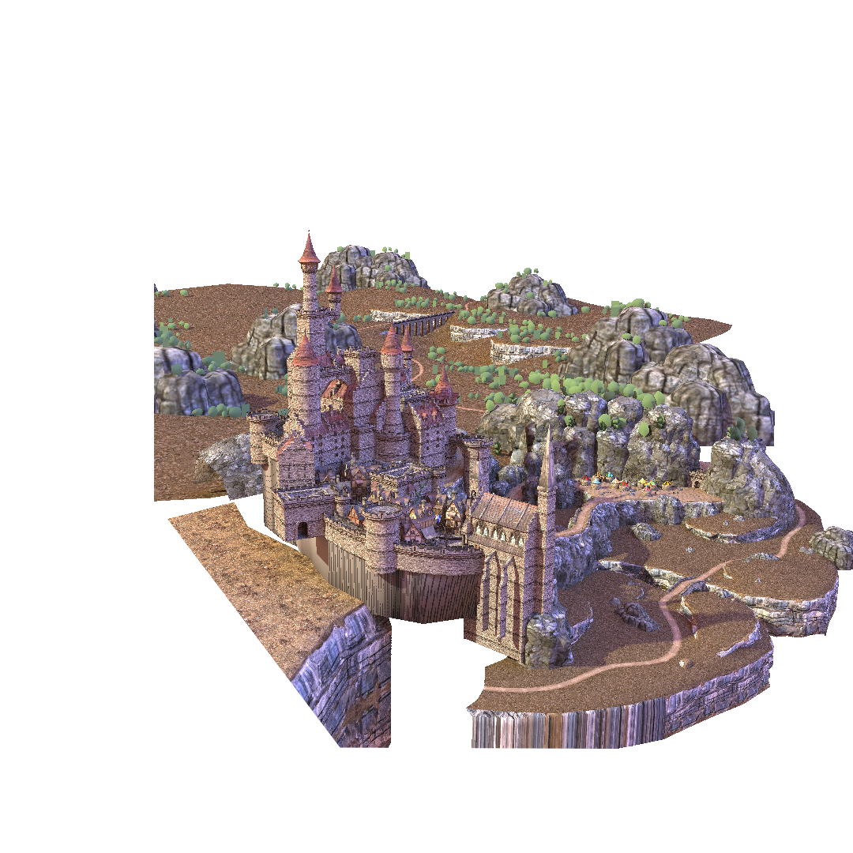
Compressing Large DAGs
Epic Citadel
128k x 128k x 128k voxels
DAG size ~1GB
Pointerless (!) SVO 5.1GB
Notes:
At high resolutions, fitting the original SVO on GPU memory can be impossible. Since the GPU based construction algorithm also requires a fair share of temporary memory, it is often necessary to split construction into subvolumes. I will describe that briefly now.

Slide 37
Compressing Large DAGs
Create a dense top of the tree:
Notes:
At high resolutions, fitting the original SVO on GPU memory can be impossible. Since the GPU based construction algorithm also requires a fair share of temporary memory, it is often necessary to split construction into subvolumes. I will describe that briefly now.

Slide 38
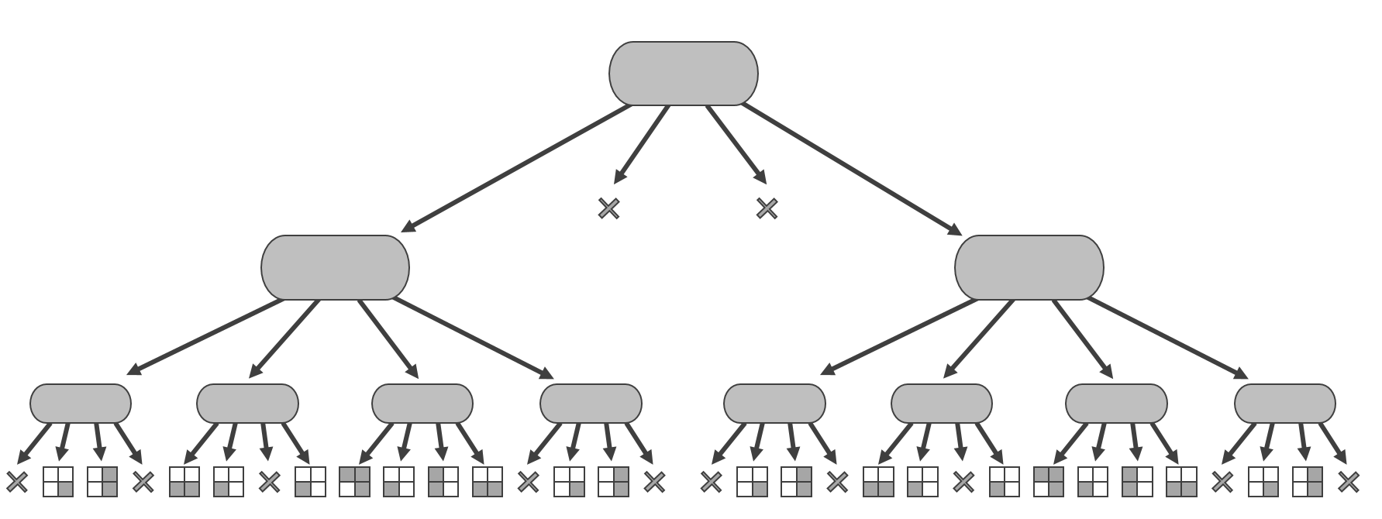
Compressing Large DAGs
Voxelize the first child
Notes:
At high resolutions, fitting the original SVO on GPU memory can be impossible. Since the GPU based construction algorithm also requires a fair share of temporary memory, it is often necessary to split construction into subvolumes. I will describe that briefly now.

Slide 39
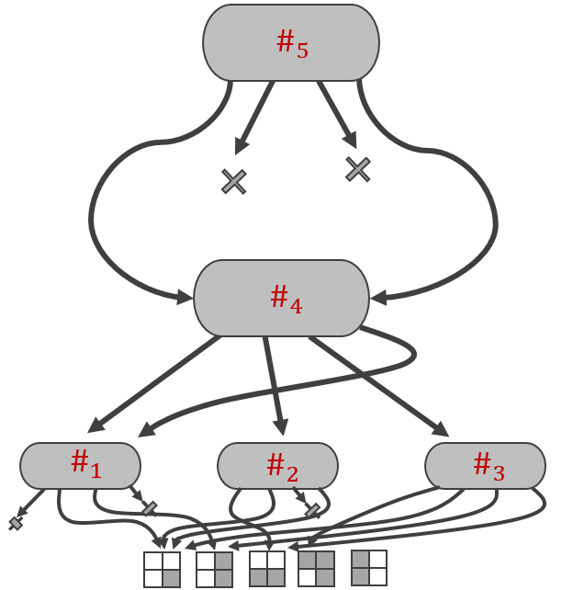
Compressing Large DAGs
Create a DAG
Notes:
At high resolutions, fitting the original SVO on GPU memory can be impossible. Since the GPU based construction algorithm also requires a fair share of temporary memory, it is often necessary to split construction into subvolumes. I will describe that briefly now.

Slide 40
Compressing Large DAGs
Voxelize and Compress a second child
Notes:
At high resolutions, fitting the original SVO on GPU memory can be impossible. Since the GPU based construction algorithm also requires a fair share of temporary memory, it is often necessary to split construction into subvolumes. I will describe that briefly now.

Slide 41
Compressing Large DAGs
End up with a partially reduced DAG
Notes:
When we have done this for all subvolumes, we end up with a partially reduced DAG.
That is, all of these subtrees are optimally compressed, but there may well be subtrees in this tree that are identical to subtrees in this tree.
We already have the hash values for all the nodes, so we CAN repeat the top-down algorithm exactly as before.
However, there is one trick that can speed things up significantly.

Slide 42











Merging one level
Level 2
Level 3
$$\#_{1}$$
$$\#_{5}$$
$$\#_{6}$$
$$\#_{10}$$
$$\#_{11}$$
$$\#_{15}$$
$$\#_{3}$$
$$\#_{5}$$
$$\#_{7}$$
$$\#_{10}$$
$$\#_{11}$$
$$\#_{14}$$
Level 4
Notes:
Since nodes in any level are already sorted, we do not have to perform a proper sort in our top down algorithm.
Simply merge the two levels in a linear sweep through the arrays.

Slide 43



Merging one level
Level 2
Level 3
$$\#_{1}$$
$$\#_{3}$$
$$\#_{5}$$
$$\#_{6}$$
$$\#_{10}$$
$$\#_{11}$$
$$\#_{15}$$
$$\#_{5}$$
$$\#_{7}$$
$$\#_{10}$$
$$\#_{11}$$
$$\#_{14}$$
Level 4
Notes:
Since nodes in any level are already sorted, we do not have to perform a proper sort in our top down algorithm.
Simply merge the two levels in a linear sweep through the arrays.

Slide 44



Merging one level
Level 2
Level 3
$$\#_{1}$$
$$\#_{3}$$
$$\#_{5}$$
$$\#_{5}$$
$$\#_{6}$$
$$\#_{10}$$
$$\#_{11}$$
$$\#_{15}$$
$$\#_{7}$$
$$\#_{10}$$
$$\#_{11}$$
$$\#_{14}$$
Level 4
Notes:
Since nodes in any level are already sorted, we do not have to perform a proper sort in our top down algorithm.
Simply merge the two levels in a linear sweep through the arrays.

Slide 45




Merging one level
Level 2
Level 3
$$\#_{1}$$
$$\#_{3}$$
$$\#_{5}$$
$$\#_{5}$$
$$\#_{6}$$
$$\#_{7}$$
$$\#_{10}$$
$$\#_{11}$$
$$\#_{15}$$
$$\#_{10}$$
$$\#_{11}$$
$$\#_{14}$$
Level 4
Notes:
Since nodes in any level are already sorted, we do not have to perform a proper sort in our top down algorithm.
Simply merge the two levels in a linear sweep through the arrays.

Slide 46

Merging one level
Level 2
Level 3
$$\#_{1}$$
$$\#_{3}$$
$$\#_{5}$$
$$\#_{5}$$
$$\#_{6}$$
$$\#_{7}$$
$$\#_{10}$$
$$\#_{10}$$
$$\#_{11}$$
$$\#_{15}$$
$$\#_{11}$$
$$\#_{14}$$
Level 4
Notes:
Since nodes in any level are already sorted, we do not have to perform a proper sort in our top down algorithm.
Simply merge the two levels in a linear sweep through the arrays.

Slide 47
Merging one level
Level 2
Level 3
$$\#_{1}$$
$$\#_{3}$$
$$\#_{5}$$
$$\#_{5}$$
$$\#_{6}$$
$$\#_{7}$$
$$\#_{10}$$
$$\#_{10}$$
$$\#_{11}$$
$$\#_{11}$$
$$\#_{14}$$
$$\#_{15}$$
Level 4
Notes:
Then, we simply remove redundant nodes and update the parent pointers as usual.

