Slide 1
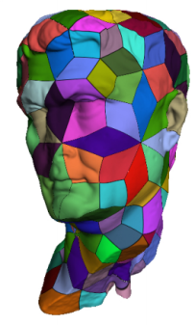
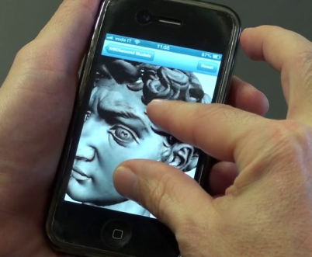
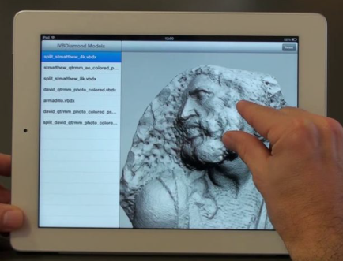
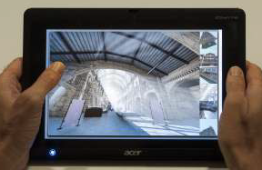
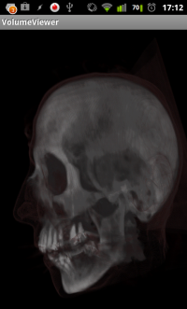
Part 5
Scalable mobile visualization

Slide 2
Mobile platforms scenario
Mobile hardware is continuously improving at impressive paces.
Screen resolutions are often extremely large. (2 – 6 Mpix)
Mobile 3D graphics hardware is powerful but still constrained
Major limiting factors wrt desktop counterparts
  low computing powers
  low memory bandwidths
  small amounts of memory
  limited power supply.
Try to circumnavigate these limitations
  In order to achieve scalable mobile rendering

Slide 3
Mobile rendering scenario
Requirements
  Hi quality interactive images
Constraints
  Limited GPU, RAM and Bandwidth
No brute force method applicable
  Need for “smart methods” to perform interactive rendering
  Exploit at best reduced rendering power
Proposed solutions
  Render only necessary data: adaptive multiresolution
  Data not already available on device: streaming approach
  Exploit at best available bandwidth: data compression

Slide 4
Related Work on mobile visualization
remeber previous session for details
Remote Rendering
  …..
Local Rendering
  Model based
    Original models
    Multiresolution models
    Simplified models
      Line rendering
      Point cloud rendering
  Image based
    Image impostors
    Environment maps
    Depth images
  Smart shading
  Volume rendering

Slide 5
Related Work on mobile visualization
remeber previous session for details
Remote Rendering
  …..
Local Rendering
  Model based
    Original models
    Multiresolution models
    Simplified models
      Line rendering
      Point cloud rendering
  Image based
    Image impostors
    Environment maps
    Depth images
  Smart shading
  Volume rendering

Slide 6
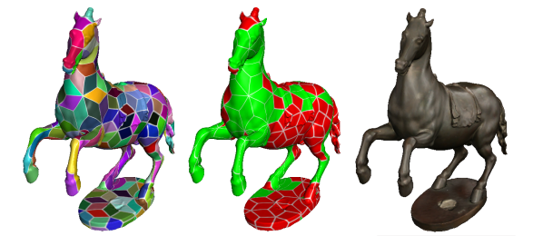
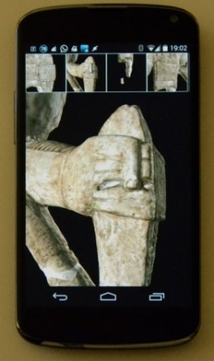
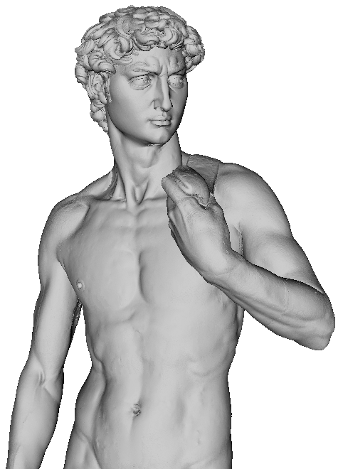
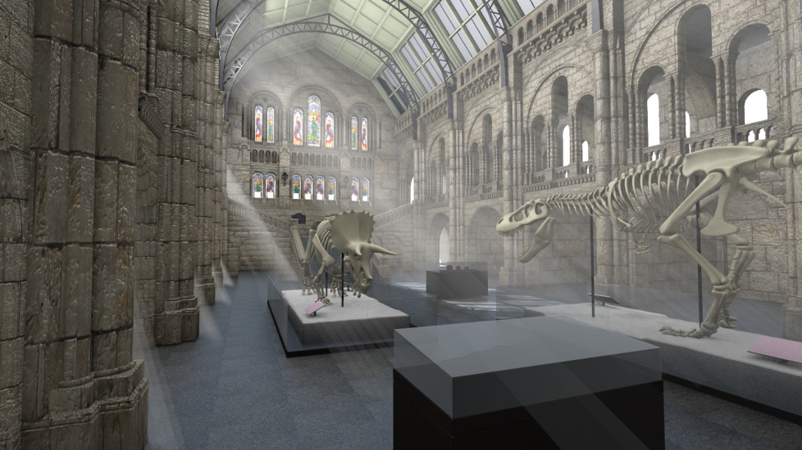
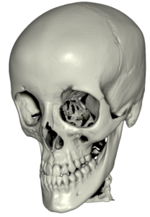
Scalable Mobile Visualization
Big/complex models:
  Detailed scenes from modeling, capturing..
    Output sensitive: adaptive multiresolution
    Compression / simple decoding
Complex rendering
  Global illumination
    Pre-computation
    Smart shading
  Volume rendering
    Compression / simple decoding

Slide 7
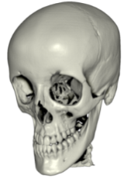
Scalable Mobile Visualization. Outline
Large meshes
High quality illumination: full precomputation
High quality illumination: smart computation
Volume data

Slide 8
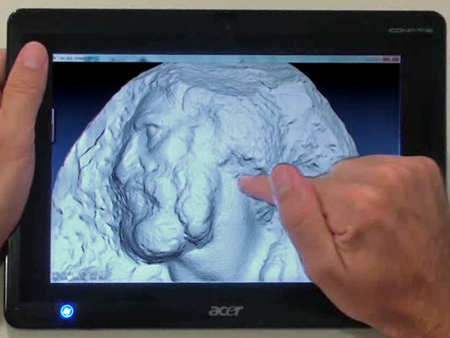
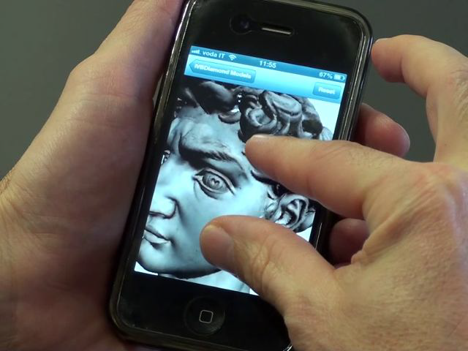
Large Meshes
Scalable Mobile Visualization
St. Matthew 374M Tri
David 1 G Tri

Slide 9
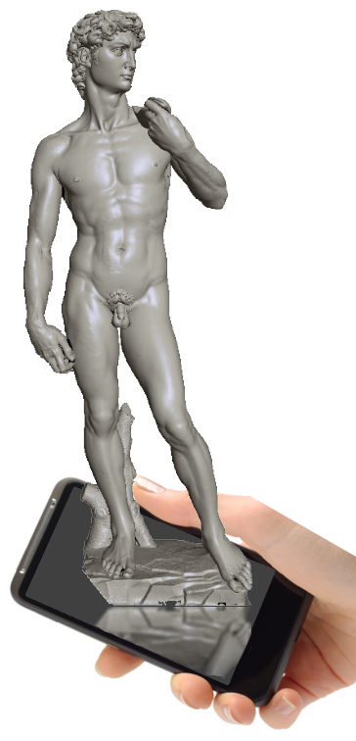
Scalable Mobile Visualization
Phenomenal
Cosmic
Models
1 G Tri

Slide 10
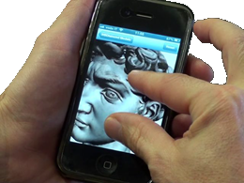
Scalable Mobile Visualization
Itty bitty living space!

Slide 11

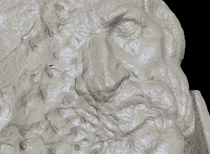
A real-time data filtering problem!
Models of unbounded complexity on limited computers
  Need for output-sensitive techniques (O(N), not O(K))
    We assume less data on screen (N) than in model (K →∞)
Storage
Screen
View parameters
I/O
Projection + Visibility + Shading
O(K=unbounded) bytes (triangles, points, …)
Limited bandwidth
(network/disk/RAM/CPU/PCIe/GPU/…)
10-100 Hz
O(N=1M-100M) pixels

Slide 12
A real-time data filtering problem!
Models of unbounded complexity on limited computers
  Need for output-sensitive techniques (O(N), not O(K))
    We assume less data on screen (N) than in model (K →∞)
Small
Working Set
Storage
Screen
View parameters
I/O
Projection + Visibility + Shading
O(K=unbounded) bytes (triangles, points, …)
Limited bandwidth
(network/disk/RAM/CPU/PCIe/GPU/…)
10-100 Hz
O(N=1M-100M) pixels

Slide 13
Proposed approaches
Output sensitive techniques: adaptive multiresolution
  Algorithm complexity proportional to pixel count, not to model size
Chunk-based multiresolution structures
  Amortize selection costs over groups of primitives
  Same structure used for visibility and detail culling
Seamless combination of chunks
  Dependencies ensure consistency at the level of chunks
Data compression
  Fast GPU decompression or compression domain rendering
Chunk-based external memory management
  Streaming, compressed data, caching
Minimize CPU workload
  Move computation to GPU
Complex rendering primitives
  GPU programming features (curvilinear patches)

Slide 14
Mobile mandatory requirements
Output sensitive techniques: adaptive multiresolution
  Algorithm complexity proportional to pixel count, not to model size
Chunk-based multiresolution structures
  Amortize selection costs over groups of primitives
  Same structure used for visibility and detail culling
Seamless combination of chunks
  Dependencies ensure consistency at the level of chunks
Data compression
  Fast GPU decompression or compression domain rendering
Chunk-based external memory management
  Streaming, compressed data, caching
Minimize CPU workload
  Move computation to GPU
Complex rendering primitives
  GPU programming features (curvilinear patches)

Slide 15

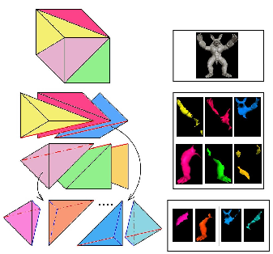
Chunked multiresolution structures
Two surface representation approaches integrated in a common framework with
  Compression, Streaming, Rendering
  Fixed coarse subdivision
    Multiresolution inside patch
  Adaptive coarse subdivision
    Global multiresolution

Slide 16
Generic approach for simple 3D models
Predefined structure with fixed number of quad patches
Multiresolution structure per patch
Compressed data loaded incrementally on demand
Reuse components: compressed images.png
Adaptive rendering handled almost totally in GPU
Works both on Mobile and WebGL
Works with topologically simple clean manifold meshes

Slide 17

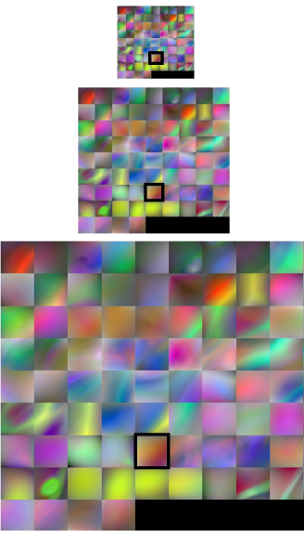
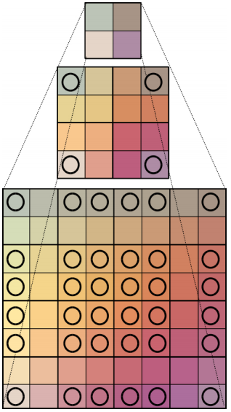
Adaptive Quad Patches: simplified streaming & rendering for mobile & web
Models partitioned into fixed number of quad patches
  Geometry encoded as detail with respect to the 4 corners interpolation
For each quad: 3 multiresolution pyramids
  Detail geometry
  Normals
  Colors
Data encoded as images
  Exploit .png (lossless compression)
Ensure connectivity
  Duplicated boundary information

Slide 18
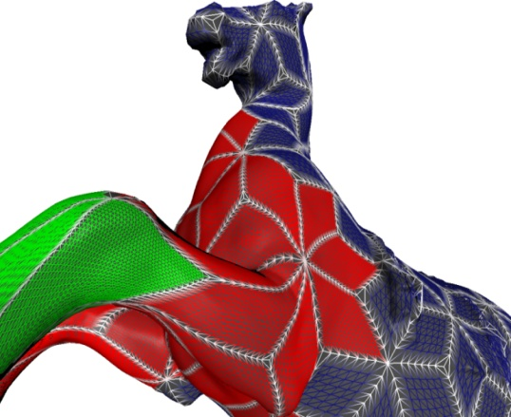

Adaptive rendering
1. CPU LOD Selection
  Find edge LODs
  Quad LOD = max edge LODs
  If data available use it, otherwise
    Query data for next frames
    Use best available representation
  Send VBO with regular grid (1 for each LOD)
2. GPU: Vertex Shader
  Snap vertices on edges (match neighbors)
  Base position = corner interpolation (u,v)
  Displace VBO vertices
    normal + displacement (dequantized)
3. GPU: Fragment Shader
  Texturing & Shading
1,1
0,0 u,v
Shared Boundary
Representation
P₁
Inner Vertex
P₂
P₀
P₃

Slide 19

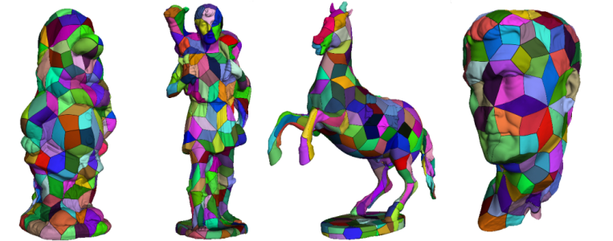
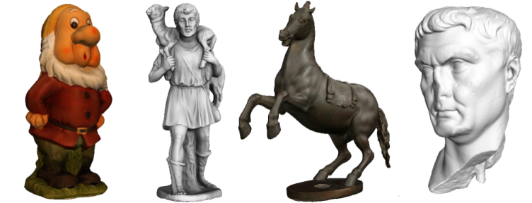
Results
St. Matthew | 374 M Tri
Avg bps (geo + col + norm) | 24.3 (6.3 + 9.5 + 8.5)
Pixel Accuracy | 1
FPS avg | 37
FPS min | 13
ADSL 8Mbps refine time | 2s for model from scratch

Slide 20
Conclusions: Adaptive Quad Patches
Effective creation and distribution system
  Fully automatic
  Compact, streamable and renderable 3D model representations
  Low CPU overhead → GPU adaptive rendering
  Mobile, WebGL
Limitations
  Closed objects with large components (i.e,3D scanned objs)
Next ? More general method
Notes:
enhancement and application in this peculiar web-based environment has resulted in very positive performance measurements and user experience

Slide 21
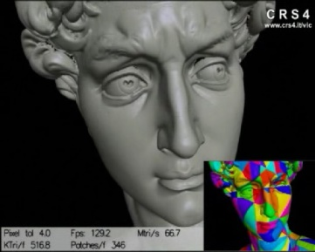
Compact Adaptive Tetra Puzzles
Efficient distribution and rendering for mobile
Built on Adaptive TetraPuzzles [CRS4+ISTI CNR, SIGGRAPH’04]
More general models
  Regular conformal hierarchy of tetrahedra
  Spatially partition input mesh
    Mesh fragments at different resolutions
    Associated to implicit diamonds
Objective
  Mobile
    Limited resources / performance
  Compact GPU representation
    Good compression ratio (maximize resource usage)
    Low decoding complexity (maximize decoding/rendering performance)

Slide 22

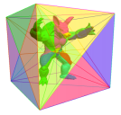
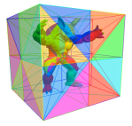
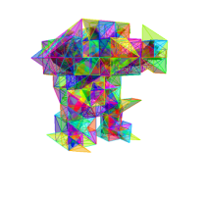
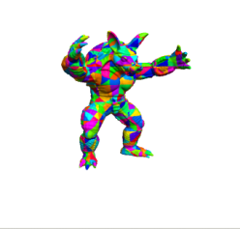
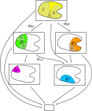



Overview
Construction
  Start with hires triangle soup
  Partition model
  Construct non-leaf cells by bottom-up recombination and simplification of lower level cells
  Assign model space errors to cells
Rendering
  Refine graph
  Render selected precomputed cells
Partitioning
Constrained simplification +
Chunk error computation
Adaptive rendering
Cache
GPU
On-line
Ensure continuity → Shared information on borders

Slide 23
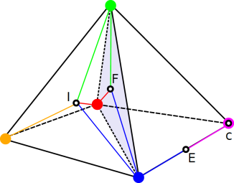
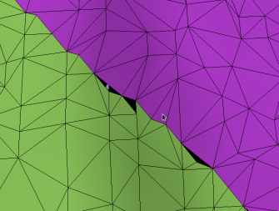

Our approach
Geometry clipped against containing tetrahedra
Vertices: tetrahedra barycentric coordinates
  P_{barycentric} = λ₁*P₁+λ₂*P₂+λ₃*P₃+λ_{4*}P₄
Seamless local quantization
  Inner vertices (I): 4 corners
  Face vertices (F): 3 corners
  Edge vertices (E): 2 corners
GPU friendly compact data representation
  8 bytes = position (3 bytes) + color (3 bytes)+ normal(2 bytes)
  Normals encoded with the octahedron approach [Meyer et al. 2012]
Further compression with entropy coding
  exploiting local data coherence
P3
P2
P1
P4

Slide 24
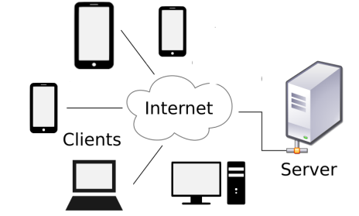
Rendering process
Extract view dependent diamond cut (CPU)
Request required patches to server
  Asynchronous multithread client
  Apache 2 based server (data repository, no processing)
CPU entropy decoding of each patch
For each node (GPU Vertex Shader):
  VBO with barycentric coordinates, normals and colors (64 bpv)
  Decode position : P = MV * [C0 C1 C2 C3] * [Vb]
    Vb is the vector with the 4 barycentric coords
    C0..C3 are tetrahedra corners
  Decode normal from 2 bytes encoding [Meyers et al. 2012]
  Use color coded in RGB24
FRONT
Apache 2

Slide 25
Results
Input Models
  St. Matthew 374 MTri
  David 1GTri
Compression:
  40 to 50 bits/vertex
Streaming full screen view
  30s on wireless,
  45s on 3G
  David 14.5MB (1.1 Mtri)
  St. Matthew 19.9MB (1.8 Mtri)
Rendering | iPad 3° gen | iPhone 4
Pixel tolerance | 3 | 3
Triangle throughput | 30 Mtri/s | 2.8 Mtri/s
FPS avg | 35 | 10
FPS refined views | 15 | 2.8
Triangle Budget | 2 M | 1 M
Notes:
In this video we can see the rendering performance on the tested devices.
On the iPad, we have an average framerate of 37 fps, around 30 Mtris/s, and 15 fps on refined views, when exceeding the 2Mtris budget (defined cache size)
On the iPhone, the average frame rate is of 10 fps, with 2.8fps on refined views. This represents around 2.8Mtris/s.

Slide 26
Conclusions: Compact ATP
Generic gigantic 3D triangle meshes on common handheld devices
  Compact, GPU friendly, adaptive data structure
    Exploiting the properties of conformal hierarchies of tetrahedra
    Seamless local quantization using barycentric coordinates
  Two-stage CPU and GPU compression
    Integrated into a multiresolution data representation
Limitations
  Requires coding non-trivial data structures
  Hard to implement on scripting environments

Slide 27
Conclusions: large meshes
Various solutions for large meshes
Constrained solution: Adaptive Quad Patches
  Simple and fast
  Good compression
  Works on topologically simple models
General solution: Compact Adaptive Tetra Puzzles
  Compact data representation
  More complex code

Slide 28
Complex scenes
We have seen how to deal with complex models O(Gtri)
How to deal with real time mobile complex illumination?
Two options:
  Full precomputation
  Smart computation

Slide 29
Complex LiGHTING:
Full precomputatioN
Scalable Mobile Visualization

Slide 30
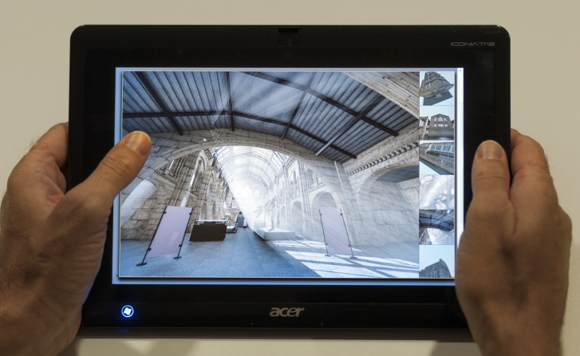
Ubiquitous exploration of scenes with complex illumination
Real-time requirement: ~30Hz
  Difficulties handling complex illumination on mobile/web platforms with current methods
Image-based techniques
  Constraining camera movement to a set of fixed camera positions
  Enable pre-computed photorealistic visualization
Explore-Maps: technique for
  Scene representation as set of probes and arcs
  Precomputed rendering for probes and transitions

Slide 31
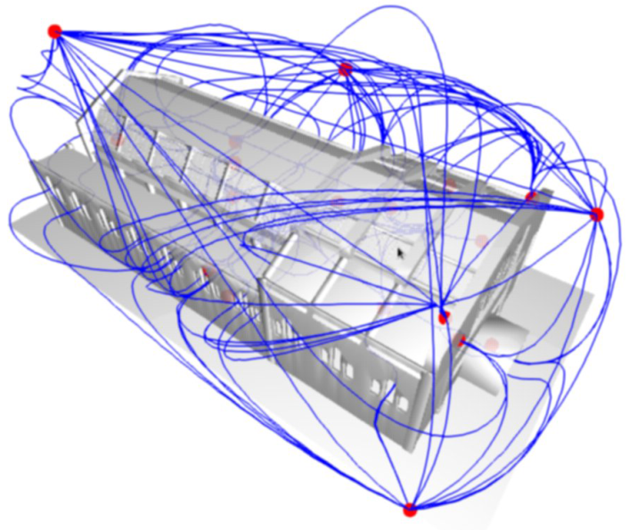
Scene Discovery
ExploreMaps: Automatic method for generating
  Set of probes providing full model coverage
    Probe = 360° panoramic point of view
  Set of arcs connecting probes
    Enable full scene navigation
Gobbetti et al. Eurographics 2014
ExploreMaps: Efficient Construction and Ubiquitous Exploration of Panoramic View Graphs of Complex 3D Environments.
Explore Map

Slide 32
Dataset Creation (rendering)
Input: Explore Map
  Probes with full scene coverage
  Transitions between “reachable” probes
Pre-processing
  Photorealistic rendering (using Blender 2.68a)
    panoramic views both for probes and transition arcs
  1024^2 probe panoramas
  256^2 transition video panoramas
  32 8-core PCs,
  Rendering times ranging from 40 minutes to 7 hours/model

Slide 33
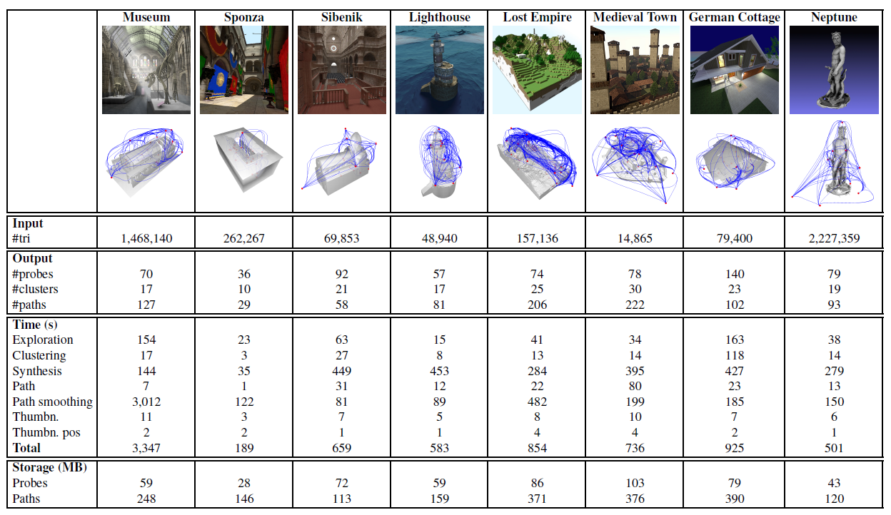
Explore Maps – Processing Results
Notes:
We have performed tests on a variety of models in order to validate our approach.
Using standard compression formats for images and video the datasets typically consist of a few hundreds of megabytes, including probes and transition videos.

Slide 34
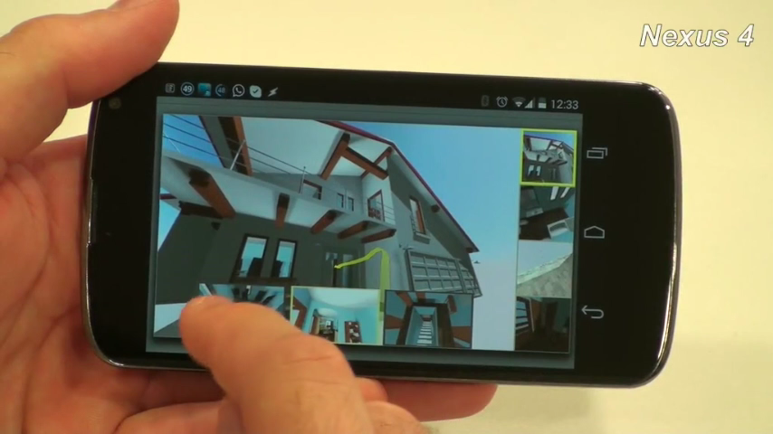
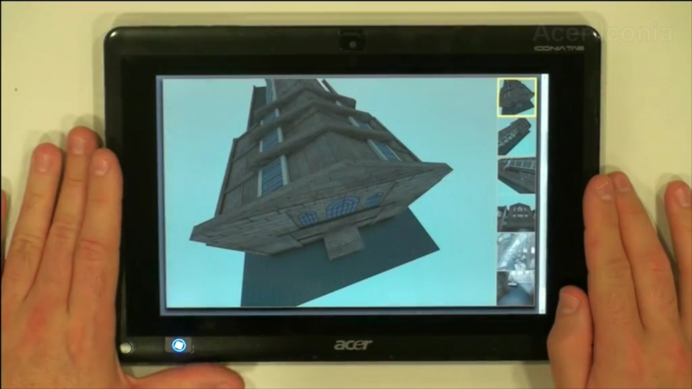
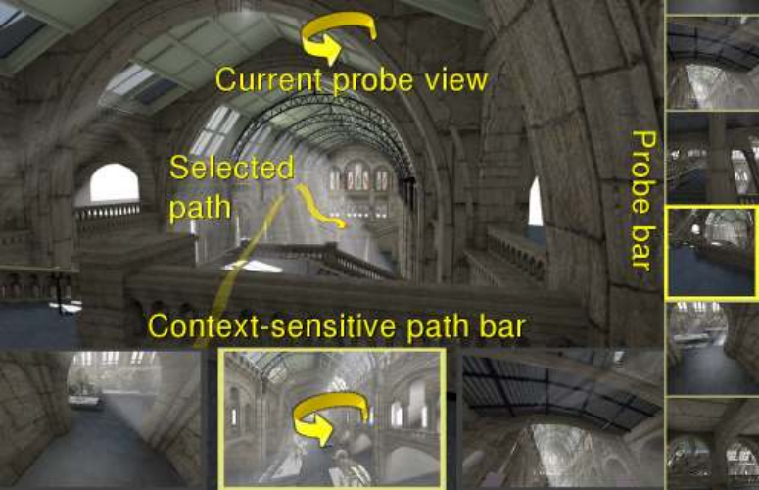
Interactive Exploration
UI for Explore Maps
  WebGL implementation + JPEG + MP4
  Panoramic images: probes + transition path
Closest probe selection
    Path alignment with current view
Thumbnail goto
  Non-fixed orientation

Slide 35
Conclusion: Interactive Exploration
Interactive exploration of complex scenes
  Web/mobile enabled
  Pre-computed rendering
    state-of-the-art Global Illumination
  Graph-based navigation → guided exploration
Limitations
  Constrained navigation
    Fixed set of camera positions
  Limited interaction
    Exploit panoramic views on paths → less constrained navigation
Next part of the talk:
  A dynamic solution for complex illumination with smart computation

Slide 36
Complex LiGHTING: Smart computation
Scalable Mobile Visualization

Slide 37
High quality illumination
Consistent illumination for AR
Soft shadows
Deferred shading
Ambient Occlusion

Slide 38
Consistent illumination for AR
High-Quality Consistent Illumination in Mobile Augmented Reality by Radiance Convolution on the GPU [Kán, Unterguggenberger & Kaufmann, 2015]
Goal
  Achieve realistic (and consistent) illumination for synthetic objects in Augmented Reality environments

Slide 39
Consistent illumination for AR
Overview
  Capture the environment with the mobile
  Create an HDR environment map
  Convolve the HDR with the BRDF’s of the materials
  Calculate radiance in realtime
  Add AO from an offline rendering as lightmaps
  Multiply with the AO from the synthetic object

Slide 40
Consistent illumination for AR
Capture the environment with the mobile
  Rotational motion of the mobile
    In yaw and pitch angles to cover all sphere directions
  Images accumulated to a spherical environment map
HDR environment map constructed while scanning
  Projecting each camera image
    According to the orientation and inertial measurement of the mobile
  Low dynamic range imaging is transformed to HDR
    Camera uses auto-exposure
      Two overlapping images will have slightly different exposure
  Alignment correction based on feature matching
  All in the device

Slide 41
Consistent illumination for AR
Convolve the HDR with the BRDF’s of the materials
  Use MRT to support several convolutions at once
  Assume distant light
  One single light reflection on the surface
  Scene materials assumed non-emissive
  Use a simplified rendering equation
Weight with AO (obtained offline)
  Built for real and synthetic objects
  Nee the geometry of the scene
    Use a proxy geometry for the objects of the real world
    Cannot be simply done on the fly

Slide 42
Consistent illumination for AR
Results
Without AO With AO
Taken from [Kán et al., 2015]

Slide 43
Consistent illumination for AR
Performance
Limitations
  Materials represented by Phong BRDF
  AO and most shading (e.g. reflection maps) is baked
3D model | # triangles | Framerate
Reflective cup | 25.6K | 29 fps
Teapot | 15.7K | 30 fps
Dragon | 229K | 13 fps

Slide 44
Soft shadows using cubemaps
Efficient Soft Shadows Based on Static Local Cubemap [Bala & Lopez Mendez, 2016]
Goal
  Soft shadows in realtime
Taken from https://community.arm.com/graphics/b/blog/posts/dynamic-soft-shadows-based-on-local-cubemap

Slide 45
Soft shadows using cubemaps
Overview
  Create a local cube map
    Offline recommended
    Stores color and transparency of the environment
    Position and bounding box
      Approximates the geometry
    Local correction
      Using proxy geometry
  Apply shadows in the fragment shader

Slide 46
Soft shadows using cubemaps
Generating shadows
  Fetch texel from cubemap
    Using the fragment-to-light vector
    Correct the vector before fetching
      Using the scene geometry (bbox) and cubemap creation position
        To provide the equivalent shadow rays
  Apply shadow based on the alpha value
  Soften shadow
    Using mipmapping and addressing according to the distance

Slide 47
Soft shadows using cubemaps
Conclusions
  Does not need to render to texture
    Cubemaps must be pre-calculated
  Requires reading multiple times from textures
  Stable
    Because cubemap does not change
Limitations
  Static, since info is precomputed

Slide 48
Physically-based Deferred Rendering
Physically Based Deferred Shading on Mobile [Vaughan Smith & Einig, 2016]
Goal:
  Adapt deferred shading pipeline to mobile
  Bandwidth friendly
  Using Framebuffer Fetch extension
    Avoids copying to main memory in OpenGL ES

Slide 49
Physically-based Deferred Rendering
Overview
  Typical deferred shading pipeline
G-Buffer Pass
Lighting Pass
Tone mapping
Postprocessing
Local Memory
Local Memory
Local Memory
G-Buffer
Depth/Stencil
Normals
Color
Light Accumulation
Tone mapped image

Slide 50
Physically-based Deferred Rendering
Main idea: group G-buffer, lighting & tone mapping into one step
G-Buffer Pass
Lighting Pass
Tone mapping
Postprocessing
Local Memory
G-Buffer & Light
Depth/Stencil
Normals
Color

Slide 51
Physically-based Deferred Rendering
Main idea: group G-buffer, lighting & tone mapping into one step
  Further improve by using Pixel Local Storage extension
    G-buffer data is not written to main memory
    Usable when multiple shader invocations cover the same pixel
  Resulting pipeline reduces bandwidth
G-Buffer Pass
Lighting Pass
Tone mapping
Postprocessing
Local Memory
Tonemapped image

Slide 52
Physically-based Deferred Rendering
Two G-buffer layouts proposed
  Specular G-buffer setup (160 bits)
    Rgb10a2 highp vec4 light accumulation
    R32f highp float depth
    3 x rgba8 highp vec4: normal, base color & specular color
  Metallicness G-buffer setup (128 bits, more bandwidth efficient)
    Rgb10a2 highp vec4 light accumulation
    R32f highp float depth
    2 x rgba8 highp vec4: normal & roughness, albedo or reflectance metallicness

Slide 53
Physically-based Deferred Rendering
Lighting
  Use precomputed HDR lightmaps to represent static diffuse lighting
    Shadows & radiosity
  Can be compressed with ASTC (supports HDR data)
    PVRTC, RGBM can also be used for non HDR formats
  Geometry pass calculates diffuse lighting
  Specular is calculated using Schlick’s approximation of Fresnel factor

Slide 54
Physically-based Deferred Rendering
Results (PowerVR SDK)
  Fewer rendering tasks
    meaning that the G-buffer generation, lighting, and tonemapping stages are properly merged into one task.
    reduction in memory bandwidth
      53% decrease in reads and a 54% decrease in writes
Limitations
  Still not big frame rates

Slide 55
Ambient Occlusion in mobile
Optimized Screen-Space Ambient Occlusion in Mobile Devices [Sunet & Vázquez, Web3D 2016]
Goal: Study feasibility of real time AO in mobile
  Analyze most popular AO algorithms: Crytek’s, Alchemy’s, Nvidia’s Horizon-Based AO (HBAO), and Starcraft II (SC2)
  Evaluate their AO pipelines step by step
  Design architectural improvements
  Implement and compare

Slide 56
Ambient Occlusion in mobile
Ambient Occlusion. Simplification of rendering equation
  The surface is a perfect diffuse surface (BRDF constant)
  Light potentially reaches a point p equally in all directions
    But takes into account point’s visibility
Light reaches the surface
Light does not reach the surface

Slide 57
Ambient Occlusion in mobile
AO typical implementations
  Precomputed AO: Fast & high quality, but static, memory hungry
  Ray-based: High quality, but costly, visible patterns…
  Geometry-based: Fast w/ proxy structures, but lower quality, artifacts/noise…
  Volume-based: High quality, view independent, but costly
  Screen-space:
    Extremely fast
    View-dependent
    [mostly] requires blurring for noise reduction
    Very popular in video games (e.g. Crysis, Starcraft 2, Battlefield 3…)

Slide 58
Ambient Occlusion in mobile
Screen-space AO:
  Approximation to AO implemented as a screen-space post-processing
    ND-buffer provides coarse approximation of scene's geometry
    Sample ND-buffer to approximate (estimate) ambient occlusion instead of shooting rays
Assassin’s Creed Unity

Slide 59
Ambient Occlusion in mobile
SSAO pipeline
  Generate ND (normal + depth, OpenGL ES 2) or G-Buffer (ND + RGB…, OpenGL ES 3.+)
  Calculate AO factor for visible pixels
    Generate a set of samples of positions/vectors around the pixel to shade.
    Get the geometry shape (position/normal…)
    Calculate AO factor by analyzing shape…
  Blur the AO texture to remove noise artifacts
  Final compositing

Slide 60
Ambient Occlusion in mobile
Optimizations. G-Buffer storage
  G-Buffer with less precision (32, 16, 8)
    8 not enough
    16 and 32 similar quality
  Normal storage (RGB vs RG)
    RGB normals are faster

Slide 61
Ambient Occlusion in mobile
Optimizations. Sampling
  AO samples generation (disc and hemisphere)
    Desktops use up to 32
    With mobile, 8 is the affordable amount
      Pseudo-random samples produces noticeable patterns
  Our proposed solution
    Compute sampling patterns offline
      2D: 8-point Poisson disc
      3D: 8-point cosine-weighted hemisphere (Malley’s approach, as in [Pharr and Humprheys, 2010])
    Scaling and rotating the resulting pattern ([Chapman, 2011])
    Predictable, reproducible, robust

Slide 62
Ambient Occlusion in mobile
Optimizations. Getting geometry positions
  Transform samples to 3D
    Inverse transform vs similar triangles
      Precision for speed
    Similar triangles are faster
  Storing depth vs storing 3D positions in G-Buffer
    Trades bandwidth for memory
    Depth slightly better
    Better profile for the application

Slide 63
Ambient Occlusion in mobile
Optimizations. Banding & Noise
  Fixed sampling pattern produces banding (left)
  Random sampling reduces banding but adds noise (middle)
  SSAO output is typically blurred to remove noise (right)
    But blurs edges

Slide 64
Ambient Occlusion in mobile
Optimizations. Banding & Noise
  User bilateral filter instead
    Works better
    Improve timings with separable filter

Slide 65
Ambient Occlusion in mobile
Optimizations. Progressive AO
  Amortize AO throughout many frames
Frame i - 1
Frame i
Partial AO
Subset of samples
ADD
Final AO
Partial AO
Subset of samples
ADD
Final AO

Slide 66
Ambient Occlusion in mobile
Optimizations
  Naïve improvement: Reduce the calculation to a portion of the screen
    Mobile devices have a high PPI resolution
    Reduction improves timings dramatically while keeping high quality
  Typical reduction:
    Offscreen render to 1/4th of the screen
    Scale-up to fill the screen

Slide 67
Ambient Occlusion in mobile
Results
Algorithm | Optimized (not progressive) | Optimized + progressive
Starcraft 2 | 17.8% | 38.5%
HBAO | 25.6% | 39.2%
Crytek | 23.4% | 35.0%
Alchemy | 24.8% | 38.2%

Slide 68
Ambient Occlusion in mobile
Conclusions
  Developed an optimized pipeline for mobile AO
    Analyzed the most popular AO techniques
      Improved several important steps of the pipeline
      Proposed some extra contributions (e.g. progressive AO)
    Achieved realtime framerates with high quality
    Developed techniques can be used in WebGL
  Future Work
    Further improvement of the pipeline
    Developing “Homebrew” method
      With all known improvements
      Some extra tricks
      Not ready for prime time yet

Slide 69
Volumetric DATA
Scalable Mobile Visualization

Slide 70
Rendering Volumetric Datasets
Introduction
Challenges
Architectures
GPU-based ray casting on mobile
Conclusions

Slide 71
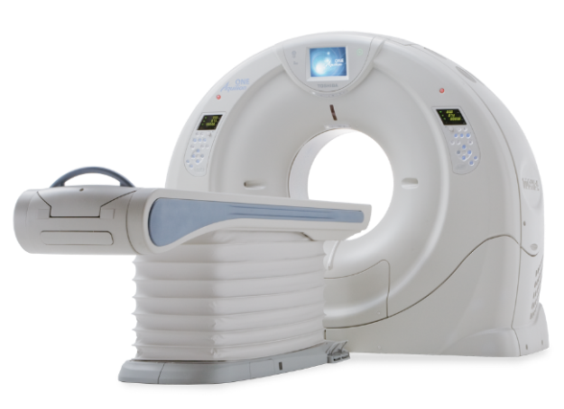
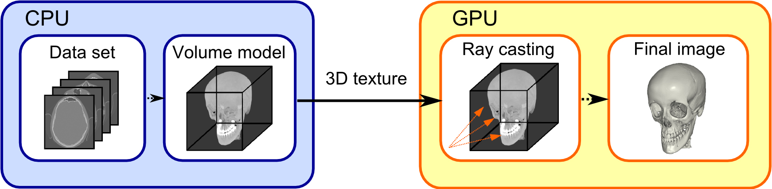
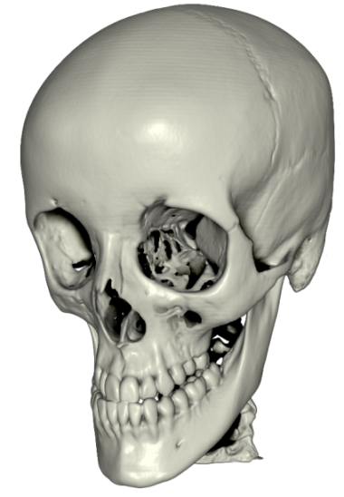
Rendering Volumetric Datasets
Capturing Rendering
3D texture
GPU- based ray casting
Output

Slide 72
Rendering Volumetric Datasets
Introduction
  Volume datasets
    Sizes continuously growing (e.g. >1024³)
      Complex data (e.g. 4D)
  Rendering algorithms
    GPU intensive
    State-of-the-art is ray casting on the fragment shader
  Interaction
    Edition, inspection, analysis, require a set of complex manipulation techniques

Slide 73
Rendering Volumetric Datasets
Desktop vs mobile
  Desktop rendering
    Large models on the fly
    Huge models with the aid of compression/multiresolution schemes
  Mobile rendering
    Standard sizes (e.g. 512³) still too much for the mobile GPUs
    Rendering algorithms GPU intensive
      State-of-the-art is GPU-based ray casting
    Interaction is difficult on a small screen
      Changing TF, inspecting the model…

Slide 74
Rendering Volumetric Datasets
Challenges on mobile:
  Memory:
    Model does not fit into memory
      Use client server approach / compress data
  GPU capabilities:
    Cannot use state of the art algorithm (e.g. no 3D textures)
      Texture arrays
  GPU horsepower:
    GPU unable to perform interactively
      Progressive rendering methods
  Small screen
    Not enough details, difficult interaction

Slide 75
Rendering Volumetric Datasets
Mobile architectures
  Server-based rendering
  Hybrid approaches
  Pure mobile rendering
  Server-based and hybrid rely on high bandwidth communication

Slide 76
Rendering Volumetric Datasets
Pure mobile rendering
  Move all the work to the mobile
  Nowadays feasible
Direct Volume Rendering on mobile. Algorithms
  Slices
  2D texture arrays
  3D textures

Slide 77


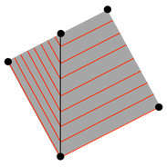
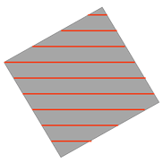

Rendering Volumetric Datasets
Axis-aligned
Slices
  Typical old days volume rendering
    Several quality limitations
    Subsampling & view change
  Improvement: Oblique slices [Kruger 2010]
View-aligned
Oblique

Slide 78
Rendering Volumetric Datasets
2D texture arrays + texture atlas [Noguera et al. 2012]
  Simulate a 3D texture using an array of 2D textures
  Implement GPU-based ray casting
    High quality
    Relatively large models
    Costly
    Cannot use hardware trilinear interpolation

Slide 79
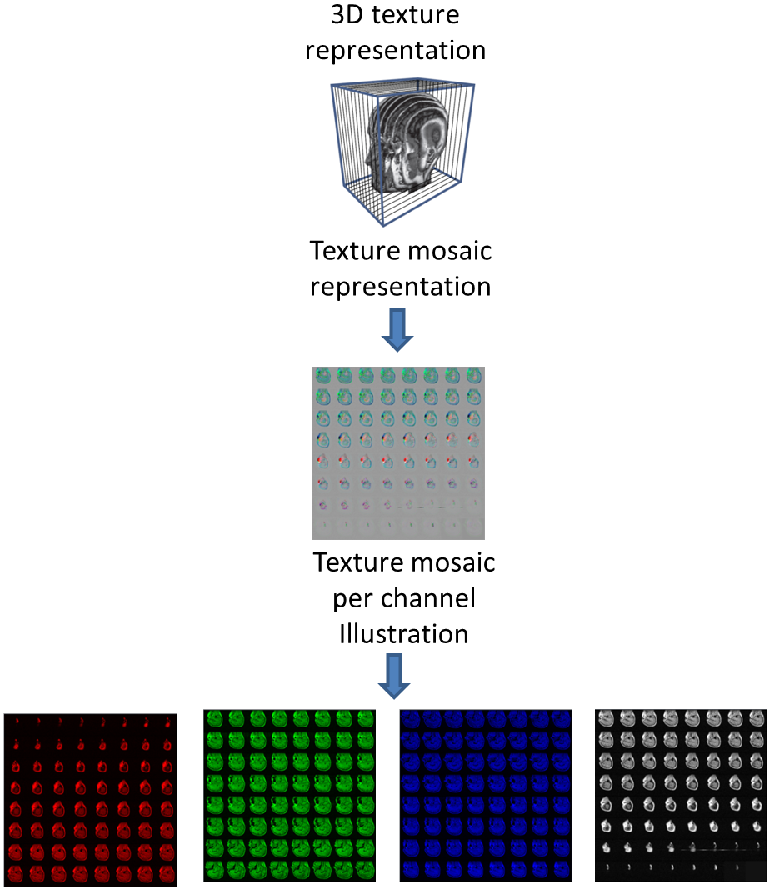
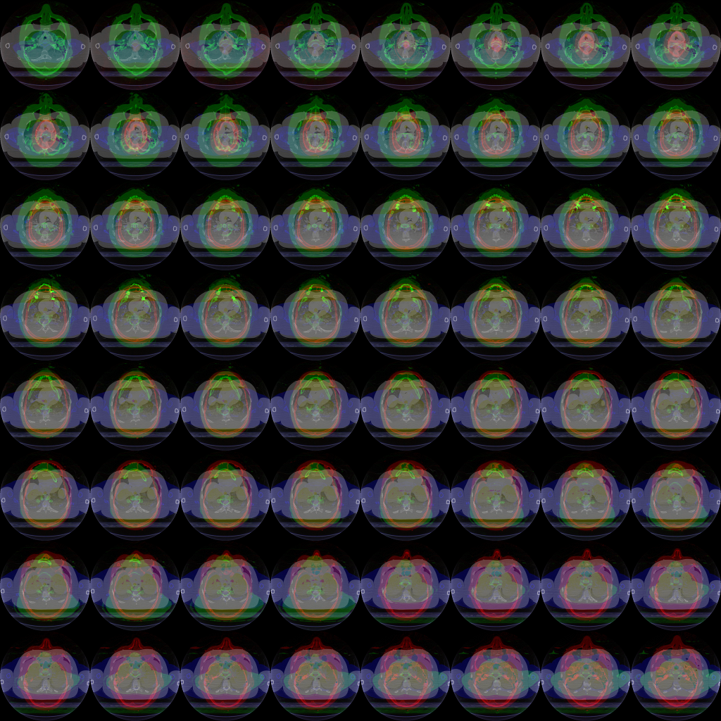
Rendering Volumetric Datasets
2D texture arrays + texture atlas

Slide 80
Rendering Volumetric Datasets
2D texture arrays + compression [Valencia & Vázquez, 2013]
  Increase the supported sizes
  Increase framerates
Compression format | Compression ratio | RBA format | RGBA format | GPU support | Overall performance | Overall quality
ETC1 | 4:1 | Yes | No | All GPUs | Good (RC) | Good
PVRTC | 8:1 and 16:1 | Yes | Yes | PowerVR | Not so good | Bad
ATITC | 4:1 | Yes | Yes | Adreno | Good (RC) | Good

Slide 81
Rendering Volumetric Datasets
2D texture arrays + compression
  ATITC: improves performance from 6% to 19%. With an average of 13.1% and a low variance of performance.
  ETC1(-P): improves performance from 6.3% to 69.5%. With an average of 32.6% and the highest variance of performance.
  PVRTC-4BPP: improves performance from 4.7% and 36.% and PVRTC-2BPP: from 9,5% to 36,5%. The average performance of both methods is ~15% with high variance.

Slide 82
Rendering Volumetric Datasets
2D texture arrays + compression
  Ray-casting: gain performance in average of 33%.
  Slice-based: gain performance in average o f 8%.
  Ray-casting frame rates are better in all cases compared to slice-based.

Slide 83
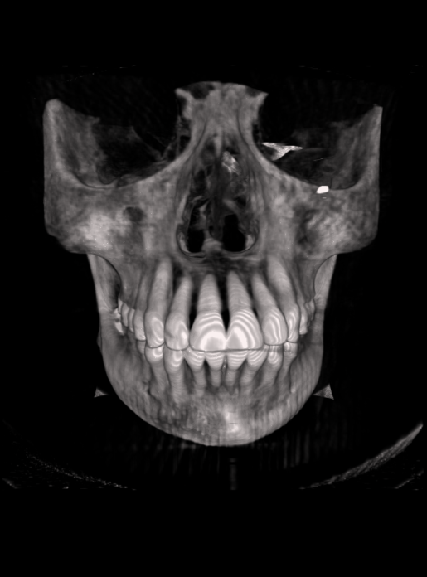
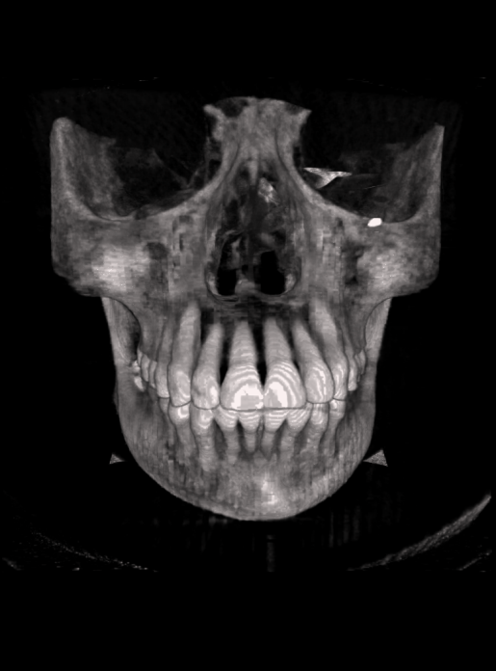

Rendering Volumetric Datasets
2D texture arrays + compression
Uncompressed | Compressed with ATI-I | Compressed with ETC1-P

Slide 84
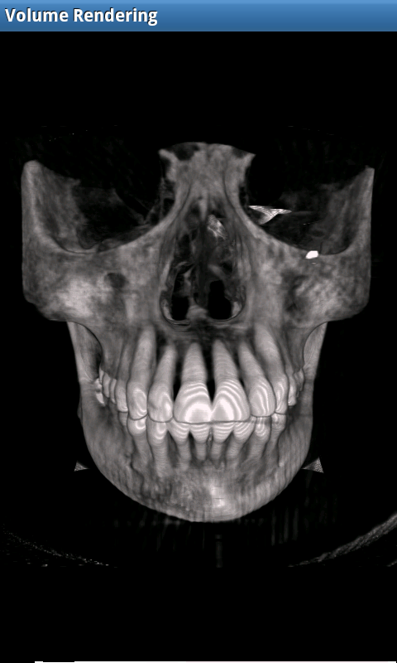
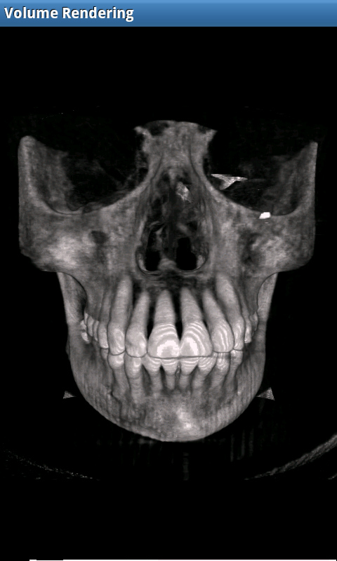
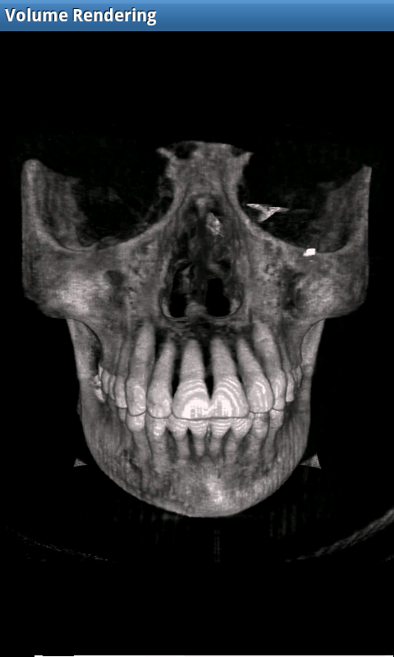
Rendering Volumetric Datasets
2D texture arrays + compression
Uncompressed | Compressed with PVRTC-4BPP | Compressed with PVRTC-2BPP

Slide 85
Rendering Volumetric Datasets
3D textures [Balsa & Vázquez, 2012]
  Allow either 3D slices or GPU-based ray casting
  Initially, only a bunch of GPUs sporting 3D textures (Qualcomm’s Adreno series >= 200)
  Performance limitations (data: 256³ – screen resol. 480x800)
    1.63 for 3D slices
    0.77 fps for ray casting

Slide 86
Rendering Volumetric Datasets

Slide 87
Rendering Volumetric Datasets
2D slices

Slide 88
Rendering Volumetric Datasets
2D slices vs 3D slices vs raycasting

Slide 89
Rendering Volumetric Datasets
Using Metal on an iOS device [Schiewe et al., 2015]
Taken from [Schiewe et al., 2015]

Slide 90
Volume data. GPU ray casting on mobile
Using Metal on an iOS device [Schiewe et al., 2015]
  Standard GPU-based ray casting
  Provides low level control
  Improved framerate (2x, to a maximum of 5-7 fps) over slice-based rendering
  Models noticeably smaller than available memory (max. size was 256²x942)

Slide 91
Rendering Volumetric Datasets
Challenges: Transfer Function edition

Slide 92
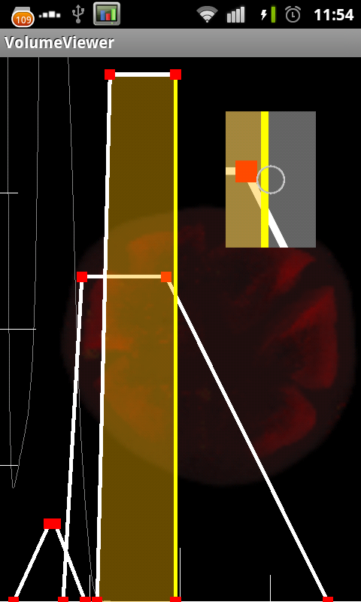

Rendering Volumetric Datasets
Challenges: Transfer Function edition
Finger
Notes:
We have also implemented a transfer function editor.
*For that we have prepared a video

Slide 93
Rendering Volumetric Datasets
Conclusion
  Volume rendering on mobile devices possible but limited
    Can use daptive rendering (half resolution when interacting)
  3D textures in core GLES 3.0
    Still limited performance (~7fps…)
  Interaction still difficult
  Client-server architecture still alive
    Can overcome data privacy/safety & storage issues
    Better 4G-5G connections
    …

Slide 94
Closing
Question & answers
Next Session

