Slide 1
Part 4
Mobile metric capture and reconstruction

Slide 2
Computer vision and mobile applications
Material
Capture
Image Search
Visual Search
Landmark recognition
Digital photos
(auto enhance)
Panoramic photos
(autostitch)
Augmented
Reality
Face detection
Biometrics
(fingerprints)
3D capture
HDR
VSLAM
1990
2000
2010

Slide 3
Computer vision and mobile applications
Mostly 2D
  Image enhancement
  Image stitching
  Image matching
  Object detection
  Texture classification
  Activity recognition
  …
Mostly 3D
  Camera localization
  Pose estimation
  3D shape recovery
  3D scene reconstruction
  Material/appearance recovery
  Augmented reality
  …

Slide 4
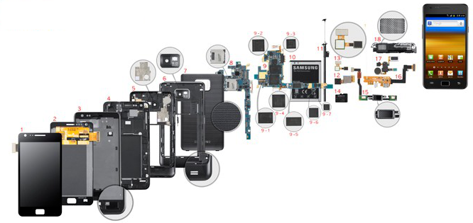
Applications made possible by specific features of mobile devices!
Features
  Mobility
  Camera
  Active light
  Non-visual sensors
  Processing power
  Connectivity
  Display

Slide 5
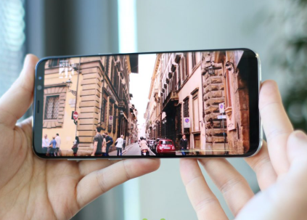
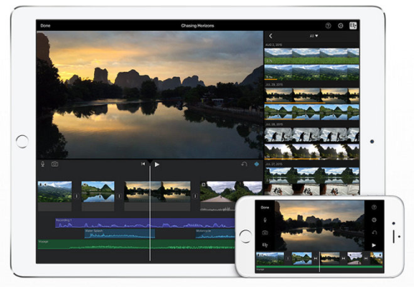
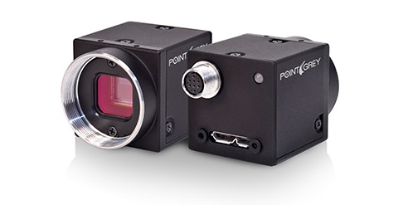
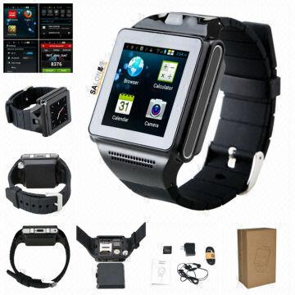
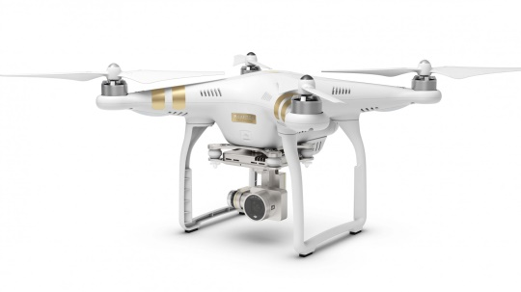
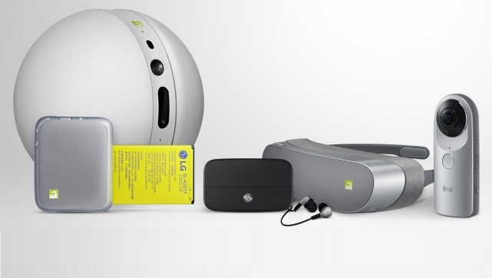
Features (1/7): Mobility
Consumer
  Smartphones
  Tablets
Embedded
  Autonomous driving
  Assistive technologies
Specific
  Drones
  Robots

Slide 6
Features (1/7): Mobility
Consumer
  Smartphones
  Tablets
Embedded
  Autonomous driving
  Assistive technologies
Specific
  Drones
  Robots
On-site applications / Personal applications / Motion and/or location taken into account / Embedded solutions

Slide 7
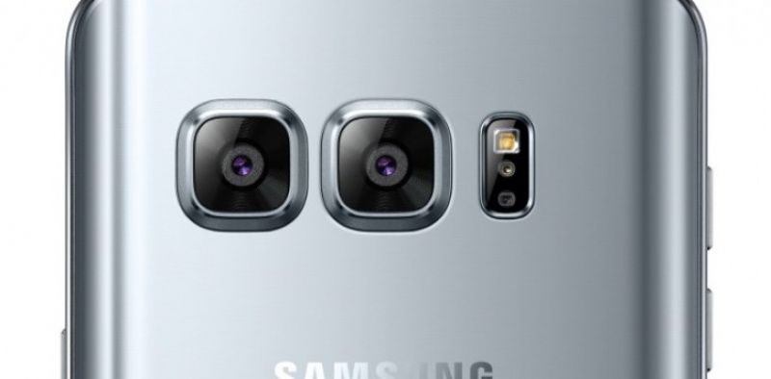
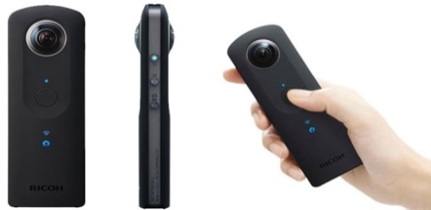
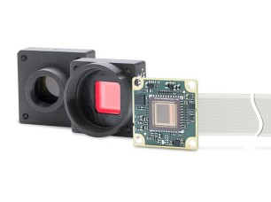
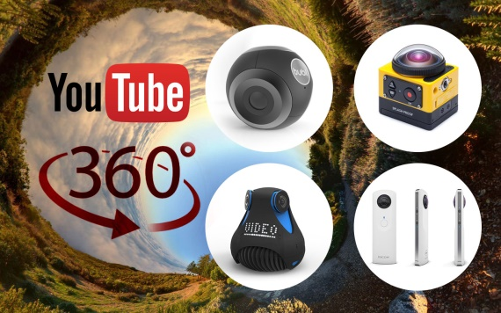
Features (2/7): High-res/flexible camera
Common features
  High resolution and good color range (>12 MP, HDR)
  Small sensors (similar to point and shoot cameras – approx. 1/3”)
  High video resolution and frame rate (4K at 30fps)
Wide variety of field of views
  standard, fisheye, spherical
Specialized embedded cameras…
  Better lenses and sensors…

Slide 8
Features (2/7): High-res/flexible camera
Common features
  High resolution and good color range (>12 MP, HDR)
  Small sensors (similar to point and shoot cameras – approx. 1/3”)
  High video resolution and frame rate (4K at 30fps)
Wide variety of field of views
  standard, fisheye, spherical
Specialized embedded cameras…
  Better lenses and sensors…
Visual channel is the primary one
Computational photography
Apps analyze/use snapshots or videos

Slide 9
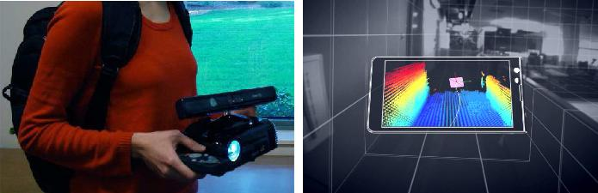
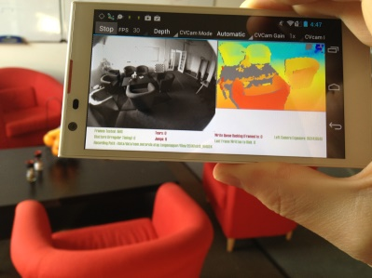
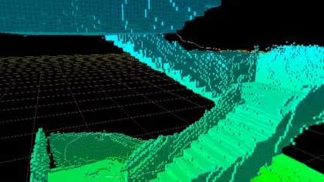
    Features (3/7): Active lighting
All smartphones have a flashlight
  LED source at fixed distance from camera
Custom devices have integrated emitters
  Google TANGO / Microsoft Kinect
    Integrated depth sensor
Leads to specialized capture procedures

Slide 10
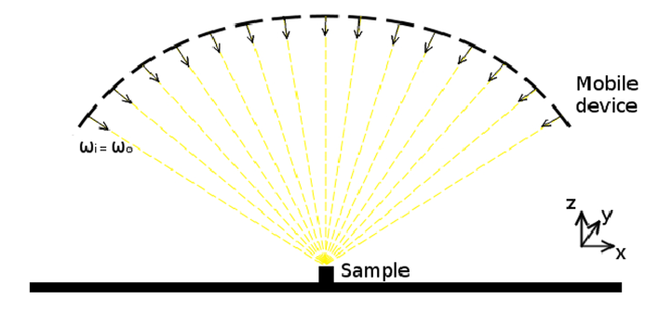

    Features (3/7): Active lighting
All smartphones have a flashlight
  LED source at fixed distance from camera
Custom devices have integrated emitters
  Google TANGO / Microsoft Kinect
    Integrated depth sensor
Leads to specialized capture procedures
Specialized capture procedures exploiting synchronization of illumination and visual sensing
Ex. Riviere et al. Mobile surface reflectometry. Computer Graphics Forum. 2015.

Slide 11
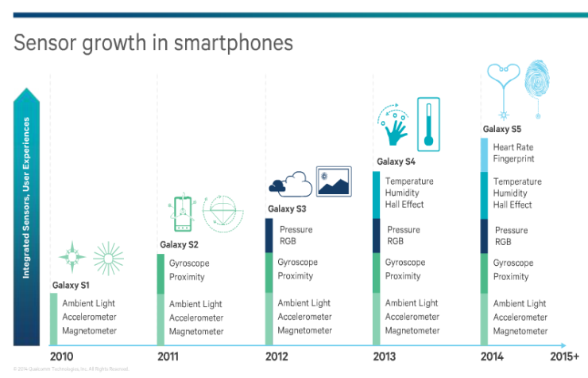
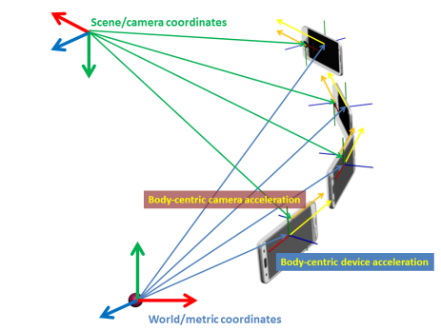
Features (4/7): Non-visual sensors
Absolute reference
  GPS / A-GPS
    Mainly for outdoor applications
  Magnetometer
    Enable compass implementation
    Often inaccurate for indoor
Relative reference
  Accelerometer
    Variable accuracy (sensitive to temperature)
    Good metric information for small scale scene
  Gyroscope
    Very good accuracy for device relative orientation
Synced with camera!

Slide 12
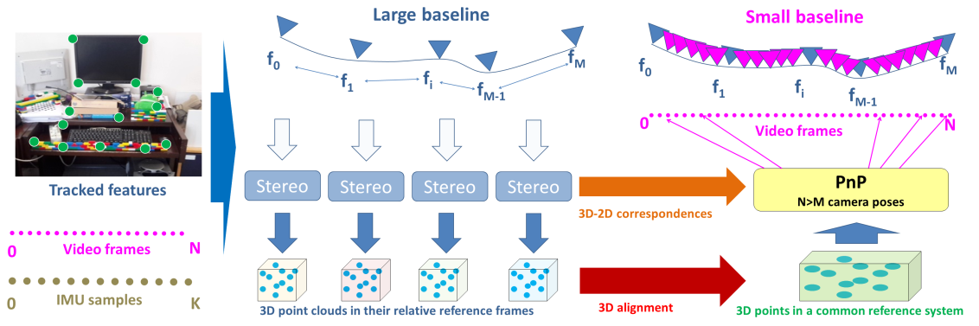
Features (4/7): Non-visual sensors
Absolute reference
  GPS / A-GPS
    Mainly for outdoor applications
  Magnetometer
    Enable compass implementation
    Often inaccurate for indoor
Relative reference
  Accelerometer
    Variable accuracy (sensitive to temperature)
    Good metric information for small scale scene
  Gyroscope
    Very good accuracy for device relative orientation
Synced with camera!
Data fusion!
Ex. Garro et al. Fast Metric Acquisition with Mobile Devices. VMV 2016
.

Slide 13
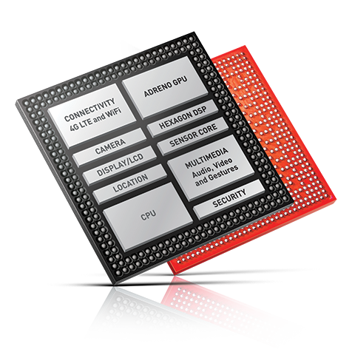
Features (5/7): Processing power
Growing performance of mobile CPU+GPU
  (see previous sections)
Capable to execture computer vision pipeline on mobile device
  i.e. OpenCV for Android
Some limitations due to power consumption

Slide 14
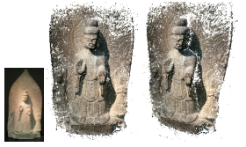
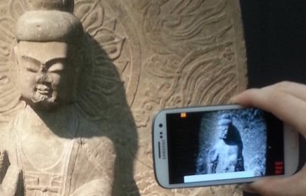
Features (5/7): Processing power
Growing performance of mobile CPU+GPU
  (see previous sections)
Capable to execture computer vision pipeline on mobile device
  i.e. OpenCV for Android
Some limitations due to power consumption
On-board pre-processing or even full processing
Ex. Tanskanen et al. Live Metric 3D Reconstruction on Mobile Phones. ICCV2013
.

Slide 15


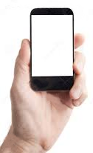

Features (6/7): Connectivity
Many connectivity options
  Local area: NFC, Bluetooth, Bluetooth Low Energy, Wi-Fi 802.11x
  Wide area: Cellular wireless networks: 3G/4G/5G
Mobile devices can connect at local or wide area at reasonable speed
  Typical LTE/4G: 18 Mbps down, 9.0 Mbps up
  Typical Wi-Fi: 54Mbps (g), 300Mbps (n), 1Gbps (ac).
Lo-cost -> No-Costs
The internet; on-line
repositories
Mobile system
Computing nodes (back
end) (cloud, server)

Slide 16
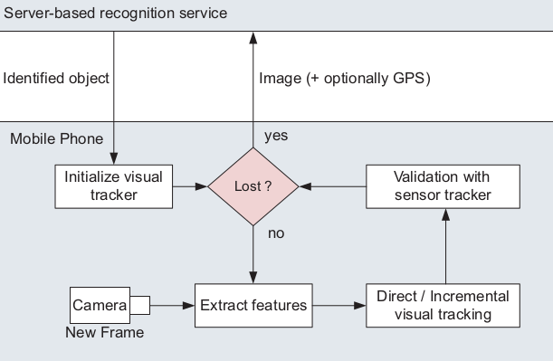
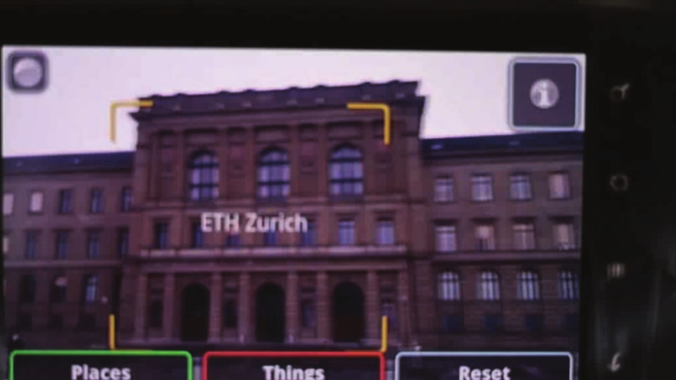
Features (6/7): Connectivity
Many connectivity options
  Local area: NFC, Bluetooth, Bluetooth Low Energy, Wi-Fi 802.11x
  Wide area: Cellular wireless networks: 3G/4G/5G
Mobile devices can connect at local or wide area at reasonable speed
  Typical LTE/4G: 18 Mbps down, 9.0 Mbps up
  Typical Wi-Fi: 54Mbps (g), 300Mbps (n), 1Gbps (ac).
Lo-cost -> No-Costs
Load balancing (client / server)
Access to large databases (e.g., search)
Communication
Ex. Gammeter et al. Server-side object recognition and client-side object tracking for mobile augmented reality. CVPRW 2010.
The internet; on-line
repositories
Mobile system
Computing nodes (back
end) (cloud, server)

Slide 17
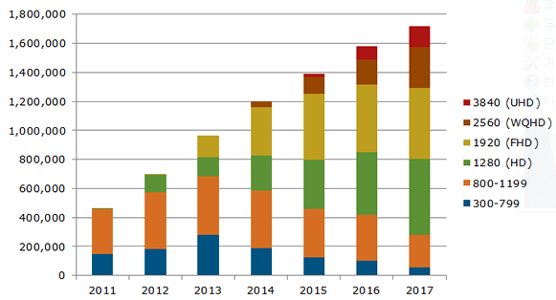
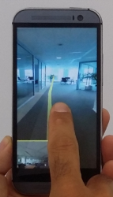
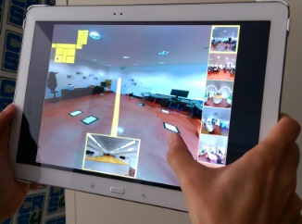
Features (7/7): Display!
Hi-res/hi-density display
  Data presentation!
Co-located with camera + other sensors
  Tracking during capture!
Touch screen
  Co-located user-interface
  (UI also may exploits other sensors)

Slide 18
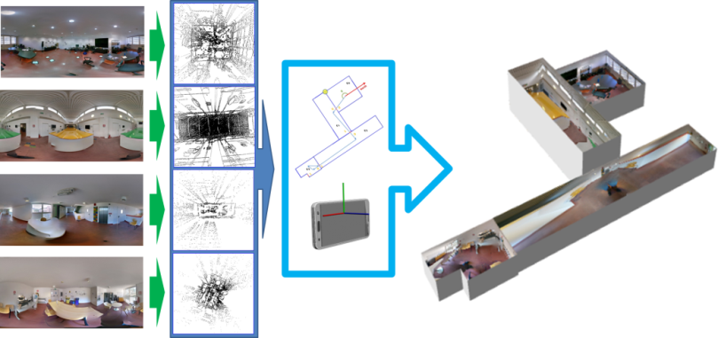
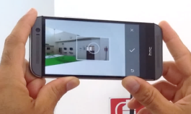
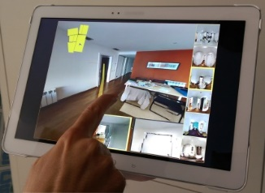
Features (7/7): Display!
Hi-res/hi-density display
  Data presentation!
Co-located with camera + other sensors
  Tracking during capture!
Touch screen
  Co-located user-interface
  (UI also may exploits other sensors)
Data/result presentation
Guided capture / Augmentation
Ex. Pintore et al. Mobile Mapping and Visualization of Indoor Structures to Simplify Scene Understanding and Location Awareness. ECCV ACVR 2016

Slide 19
Wrap-up: mobile apps characterized by the exploitation of mobile device features
Features
  Mobility
  Camera
  Active light
  Non-visual sensors
  Processing power
  Connectivity
  Display

Slide 20
Data fusion for metric capture
Example 1

Slide 21
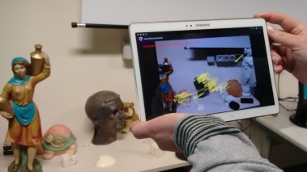
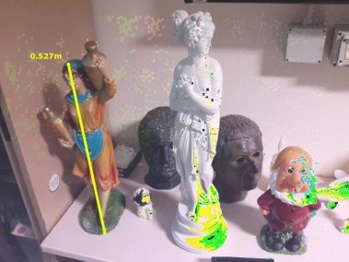
Metric acquisition with a commodity mobile phone
Goal
  Capture 3D models with real-world measures
Data fusion approach
  Exploit synchronization of visual sensor & IMU to capture scenes in real-world units
Garro et al. Fast Metric Acquisition with Mobile Devices. VMV 2016

Slide 22
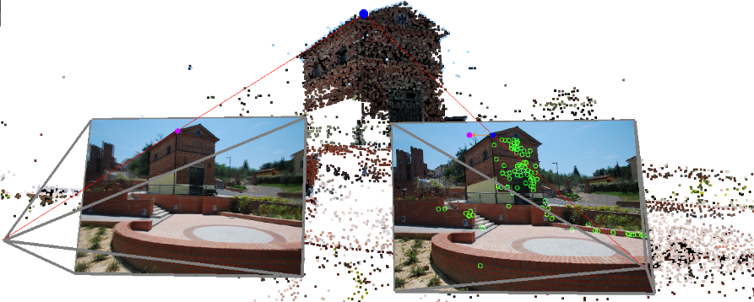
Structure-from-Motion + Dense reconstruction
SfM reconstructs a point cloud from a series of images
  3D positions of (sparse) matched features
  Camera positions and orientations
Many approaches for densification
  Pipeline showed to work at interactive rates on phones (Taskanen et al 2013)
SCALE AMBIGUITY

Slide 23
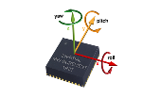
Data fusion: Visual + IMU
Use sensors synced with visual channel
  GPS+Magnetometer generally
  not applicable
  IMU returns orientation and acceleration in real world units
Idea
  track camera movement with IMU during visual capture
  use IMU data to find out the real-world distance between SfM camera positions, resolving the scale ambiguity

Slide 24
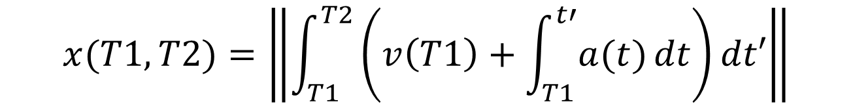
Data fusion: Visual + IMU
The accelerometer returns acceleration
Therefore, we should be able to compute the displacement between two camera positions as
Not so easy: onboard IMU sensors are biased and noisy and SfM camera positions are sparse
$$x(T1,T2)=\left\|\int_{T1}^{T2}{\left(v\left(T1\right)+\int_{T1}^{t′}{a(t)}dt\right)dt′}\right\|$$

Slide 25
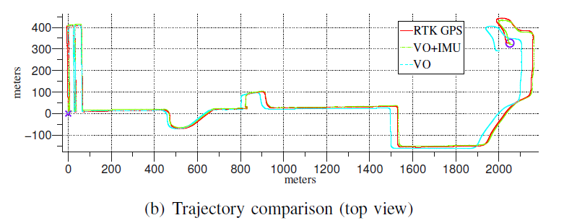
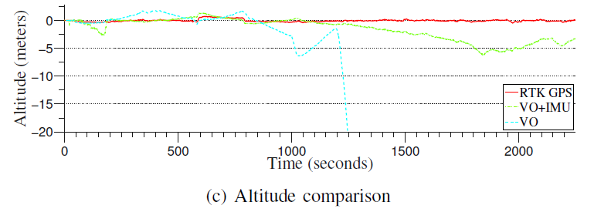
Data fusion approaches (1/5)
Match position from IMU integration with position from SfM, coping with noise/bias by extensive filtering
Requires LONG acquisition times and LONG offline processing times
Vision only
IMU only
Vision+IMU
Visual-Inertial Navigation, Mapping and Localization:
A Scalable Real-Time Causal Approach [Jones,Soatto 2011]
A new approach to vision-aided inertial
navigation [Tardif et al 2010]

Slide 26
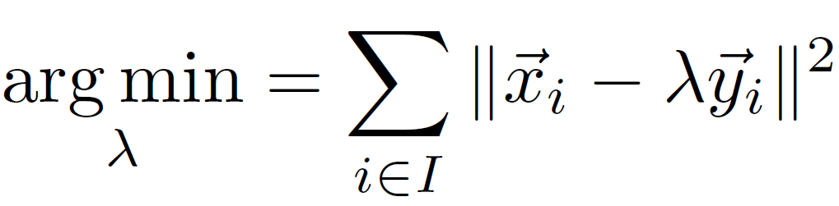
Data fusion approaches (2/5)
Ad-hoc online solutions taking into account IMU characteristics
  Segment motion in “swift movements” with large accelerations
  Integration of IMU acceleration to derive position matched with SfM
  Continuous process of outlier rejection and re-estimation of scale
Working but motion-dependent and prone to accumulation error due to integration
Live metric 3D reconstruction on
Mobile Phones [Tanskane et al. 2013]
One estimate of λ at the end of each swift movement
Estimation of scale λ only on inlier set I

Slide 27
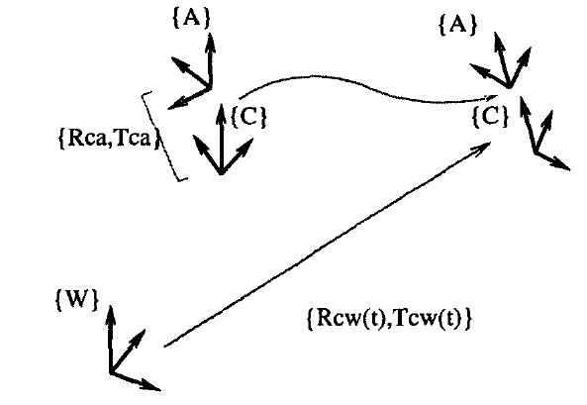
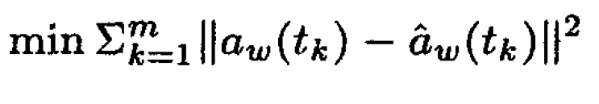
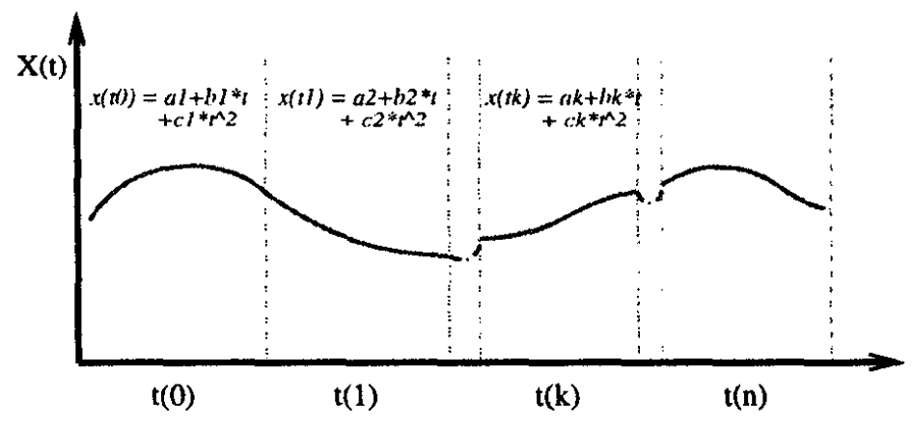
Data fusion approaches (3/5)
Match accelerations from IMU with accelerations from SfM
Works off-line and assumes high-accuracy (robotics) IMU
spline parameters
Camera trajectory estimation using inertial measurements
and Structure from Motion results [JungTaylor2001]

Slide 28
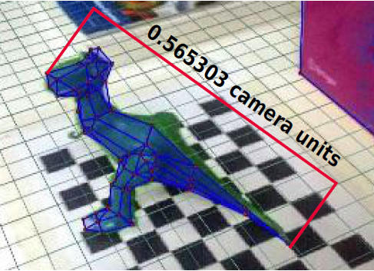
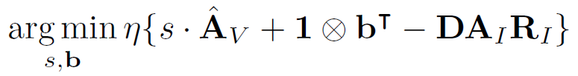
Data fusion approaches (4/5)
Match accelerations from IMU with accelerations from SfM at SfM frame-rate (large baseline!)
  Downsample and anti-alias IMU samples at SfM frame rate
  Optimize scale and bias
Requires very long acquisition times due to downsampling at SfM rate
Hand-waving away scale [Ham et al. 2014]
D: convolutional matrix for
antialising and downsampling
IMU signal

Slide 29

Data fusion approaches (5/5)
Match accelerations from IMU with accelerations from SfM at IMU frame-rate (small baseline!)
  Upsample SfM samples at high rate using all available visual data
  Estimate acceleration from upsampled transforms and match them to IMU samples using robust fitting
Fast, coping with large errors and noise
Fast Metric Acquisition with Mobile Devices. [Garro et al. 2016}
$$\underset{s,R}{argmin}\left\{\left\|A_{c}−sRA_{s}\right\|\right\}$$

Slide 30

Vision Module Pipeline

Slide 31
Vision Module
Traces Shi-Thomasi features
When baseline is large enough
  Estimate Essential Matrix, that is, relative camera pose between f0 and fi
  Calculate a 3D point for each feature point
Note: each pair of cameras has its own reference system
f₀
f₁
f_{i}

Slide 32
Vision Module
Global registration
  M point clouds
  A subset of features is present in each point cloud
  Use feature correspondence to align all the point cloud in the same reference system
Cameras upsampling
  Features are tracked for all frames
  Use aligned point cloud and tracking position to estimate cameras for all frames with Perspective-n-Point (PnP)
3D
2D
f₀
f_{M}
f₁
f_{i}
f_{M-1}

Slide 33
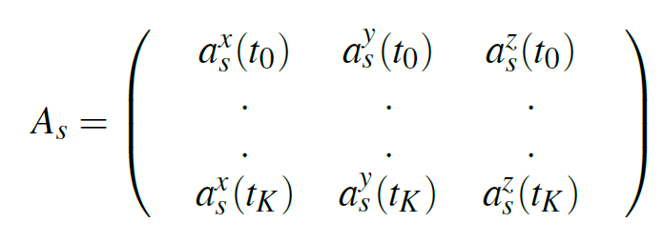
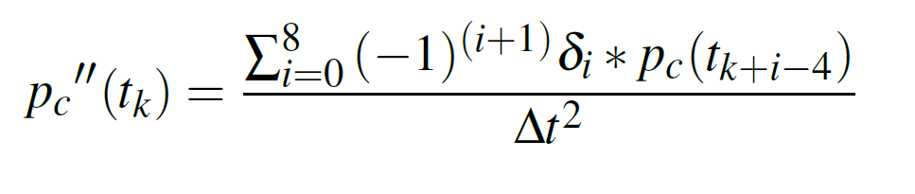
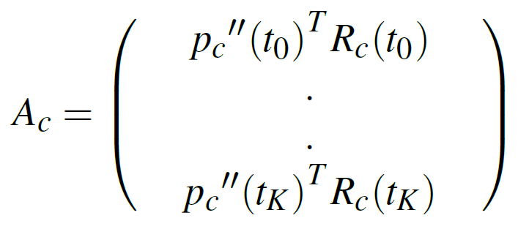




Recovering the scale factor (1/2)
IMU accelerations
$$t_{0}$$
$$t_{K}$$
$$t_{k}$$
Camera accelerations
Problem to solve
$$\underset{s}{argmin}\left\{\left\|A_{c}−sA_{s}\right\|\right\}$$

Slide 34
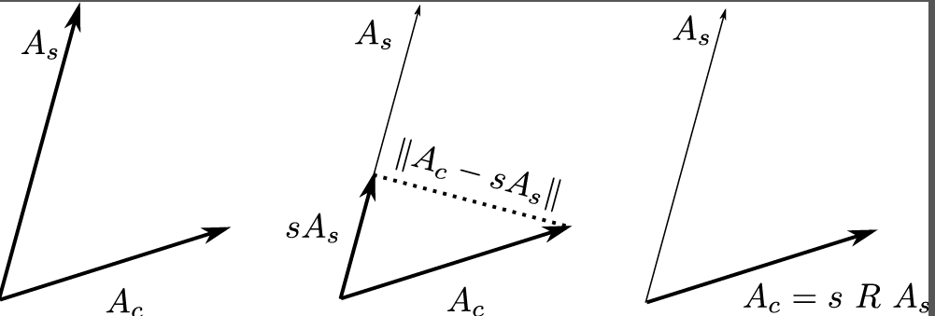


Recovering the scale factor (2/2)
LS, gradient descent (et similia) poorly conditioned
  Not so many data
  Severe outliers
Robust fitting use RANSAC approach
  Use MLESAC robust estimator to maximize likelihood rather than just the number of inliers
Introduce rotation matrix R
  Account for orientation bias
  Improve RANSAC performance
$$\underset{s}{argmin}\left\{\left\|A_{c}−sA_{s}\right\|\right\}$$
$$\underset{s,R}{argmin}\left\{\left\|A_{c}−sRA_{s}\right\|\right\}$$

Slide 35
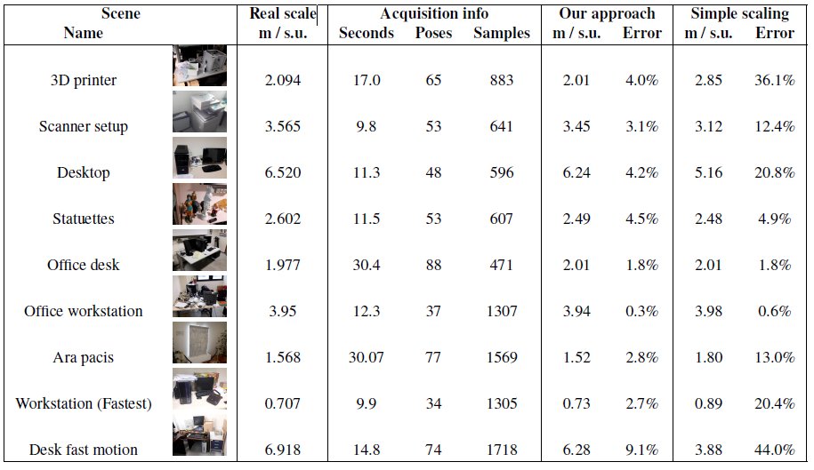
Results
Median error 4% (wrt 10-15% of other STAR solutions)

Slide 36
Data fusion and communication for indoor capture
Example 2

Slide 37
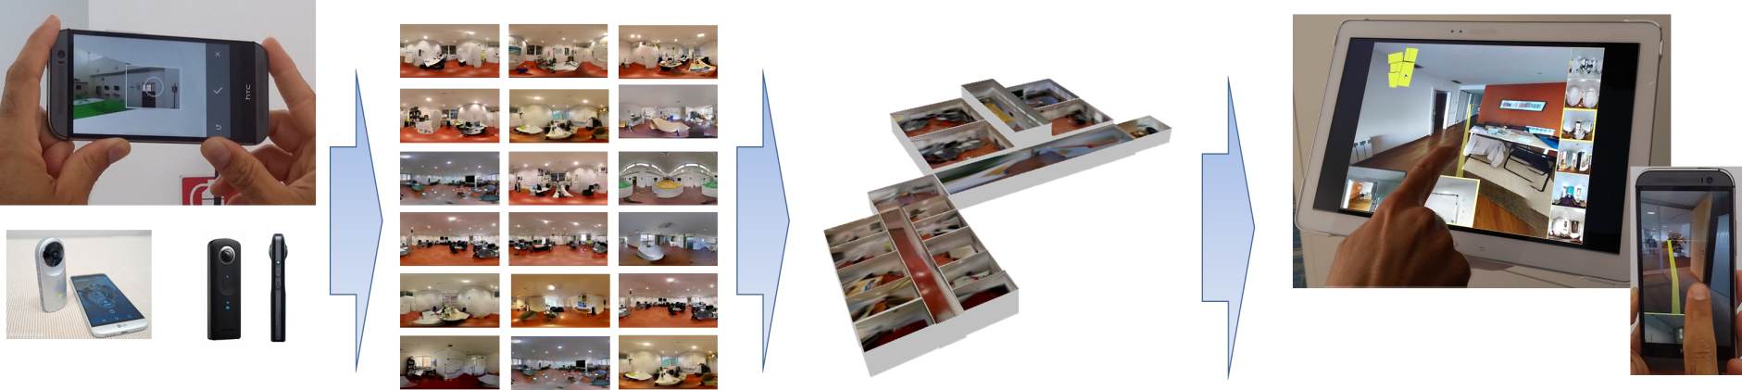
Indoor capture + presentation
Creation and sharing of indoor digital mock-ups
  Exploiting the capabilities of modern mobile devices
Much interest/applications (security, location awareness, …)
  Need to capture visual information together with room structure

Slide 38
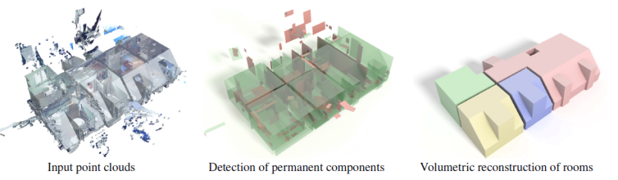



Typical solutions
Indoor capture and modeling
  Manual modeling
  Semi-automatic methods based on high-density data
    Laser scanning
      Professional but expensive, limited to specific applications
    Multi-view stereo from photographs
      Generally cost effective but hard to apply in the indoor environment
        Walls poorly textured, occlusions, clutter
        Furthermore: need for heavy MW constraints, computationally demanding
MVS
MWS
Merging
Mura et al. Piecewise-planar Reconstruction of Multi-room Interiors with Arbitrary Wall Arrangements.
Computer Graphics Forum – Pacific Graphics 2016
Furukawa et al. Reconstructing Building Interiors from Images. ICCV 2009

Slide 39




Examples using low-cost mobile devices
Interactive capture and mapping of indoor environment
  MagicPlan - http://www.sensopia.com
    Floor corners marked via an augmented reality interface
    Manual editing of the room and floor plan merging using the screen interface
  Sankar and Seitz: Capturing indoor scenes with smartphones (UIST2012)
    Corners marked on the screen during video playback

Slide 40



Exploiting panoramic images
360 degrees images are easy to capture using common devices
  Interactive apps using IMU + GUI + automatic stitching
  Dedicated cameras
360 degrees images are easy to navigate
  Spheremaps + emerging formats video+image formats
  VR devices for immersion
What about analyzing them?

Slide 41



Finding the room structure
Take one spheremap per room
  Equirectangular images generated by a mobile device
    Vertical lines aligned with the gravity vector
    Image approx. oriented towards magnetic North
  Eventually use IMU + Visual features for stitching
Track user motion to identify connections between rooms
  Use IMU + Visual Features for tracking
Solve local + global optimization to find indoor structure
  Multi-room environment

Slide 42






Finding the room structure
Analyze spheremap to extract single room structure
  Room model considers vertical walls
  Extract edges and filter out regions likely far from top/bottom edges of walls
  Find wall height
    Voting scheme used to extract most likely wall height by maximizing pairs of matching wall-floor / wall-height edge pixels
  Fit 2.5D room model to recovered wall edge map
Uses specialized transform to speed-up computation
TRANSFORM
SUPERPIXELS MASK
Floor
Ceiling
Vary h_{w} results in a transform scaling

Slide 43




Finding the rooms structure
Iterated to map the entire floor-plan
  Mobile tracking of user’s direction moving between adjacent rooms creates a connected room graph
  Doors position identification in the image by computer vision
  Doors matching according with graph
  Rooms displacement
  Global optimization of combined model
    Pintore et al. Omnidirectional image capture on mobile devices for fast automatic generation of 2.5D indoor maps. IEEE WACV 2016

Slide 44


Results
    Pintore et al. Omnidirectional image capture on mobile devices for fast automatic generation of 2.5D indoor maps. IEEE WACV 2016
Reasonable, fast reconstruction with rough structure and visual features

Slide 45



Sharing the indoor model
Indoor model
  Exploration graph
    Each node is a spheremap/room
    edges (yellow) are transitions between adjacent rooms
    Stored on a server (standard http Apache2)
  Panoramic images
    Mapped according with the graph
Interactive exploration
  Room
    WebGL fragment shader
    dragging to change view orientation and pinching to zoom in/out
  Passages
    Real-time rendering of the transitions between rooms
      Exploiting geometric model stored on the server
      Performance improvement compared to use precomputed videos
    Suggested paths

Slide 46

Some results
Live demo: http://vcg.isti.cnr.it/vasco/
Click on the dataset on the left column to start
3D reconstruction of a 655 mq office with 19 rooms.
This environment was acquired with a mobile phone
(HTC One M8)
Reconstruction of a 70 rooms floor of the NHV ministry at Den Haag, Netherlands. The whole model was acquired with a Ricoh Theta S camera

Slide 47
Wrap-up: mobile apps characterized by the exploitation of mobile device features
Features
  Mobility
  Camera
  Active light
  Non-visual sensors
  Processing power
  Connectivity
  Display

Slide 48
BREAK!
After the break: rendering!

