Slide 1
Part 2
Mobile graphics trends
Hardware architectures
Applications

Slide 2
Hardware architectures

Slide 3
Brief history of mobile graphics hardware
Apple (PowerVR)
Samsung
(mostly ARM)
Imagination
PowerVR
ARM Mali
Qualcomm Snapdragon/Adreno
AMD
Intel
Nvidia
iPhone (MBX)
MBX
Buys Phalanx
SGX535/541 (GLES 2.0)
2007
Buys PA Semi
Hummingbird (Cortex A8)
Omnia HD (TI OMAP 3 & Power VR SGX530)
Buys Imageon (Adreno)
Sells Imageon
SGX543 (GLES 2.0, GL 2.1)
Mali 400 GLES 2.0
2008
iPhone 3GS (SGX535)
SGX545 (GLES 2.0 GL 3.2)
2009
Tegra 2 (Cortex-A9, GLES 2.0)
2010
A4 (ARM Cortex A8)
Tegra 3 (Cortex-A9, GLES 2.0)
2011
Series 6XE/XT GLES 3.1 GL 3.2 (28nm)
T600 GLES 2.0, DX9.0
Adreno 530 GLES 3.1+, OpenCL 2, DX 11.2 Vulcan 1.0
2012
A7/A8 & A8X (GT64XX)
Tegra 4 (Cortex-A15, GL 4.4, 28nm)
2013
Exynos 5433/7410 (20nm, Mali-T760 MP6)
T700 GLES 3,1, DX 11.1 OpenCL 1.1
A9 (GT7600)
Series7XE Vulkan 1.0 GLES 3.1 (latter ones 10nm)
Tegra K1 (Cortex-A15, GL 4.4, 28nm)
2014
T800 GLES 3,1, DX 11.1-11.2 OpenCL 1.2
Tegra X1 (Cortex-A57, GLES 3.1, GL 4.5, Vulkan, 20nm)
2015
Plans to build its own GPU
Apple will no longer require its services in 18-24 months
2016
Next Tegra generations seem to be for automotive
Furian?
Notes:
Intel/ARM
http://www.infoworld.com/d/computer-hardware/intel-vs-arm-two-titans-tangled-fate-237265?page=0,1
AMD
http://www.anandtech.com/show/7514/amd-2014-mobile-apu-update-beema-and-mullins
http://www.enterprisetech.com/2014/05/05/amd-unify-x86-arm-systems-skybridge/

Slide 4
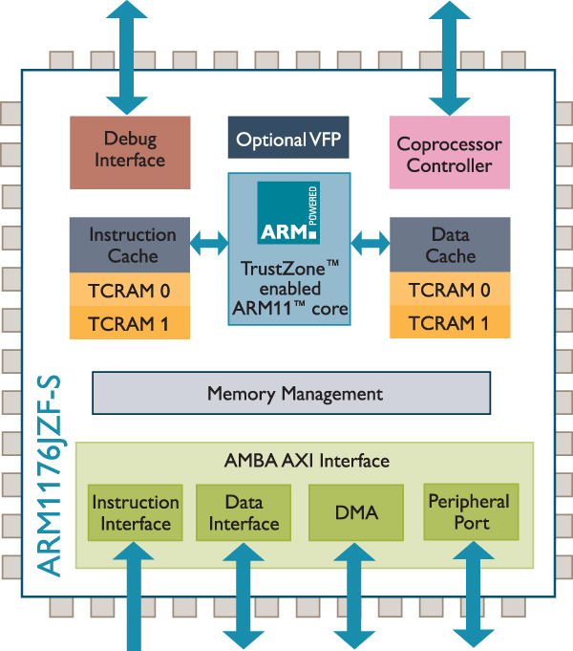
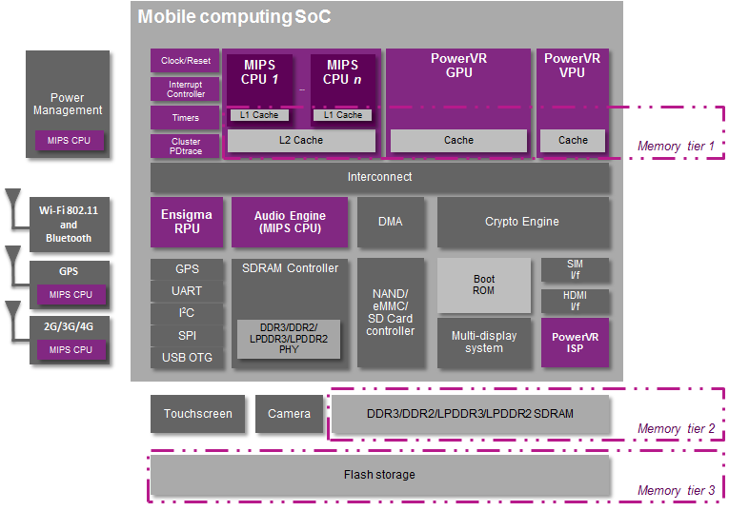
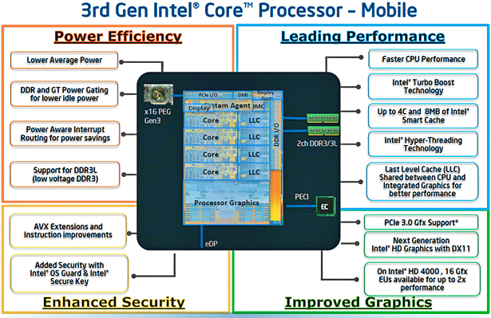
Architectures (beginning 2015)
ARM
MIPS
x86
Notes:
Intel/ARM
http://www.infoworld.com/d/computer-hardware/intel-vs-arm-two-titans-tangled-fate-237265?page=0,1
AMD
http://www.anandtech.com/show/7514/amd-2014-mobile-apu-update-beema-and-mullins
http://www.enterprisetech.com/2014/05/05/amd-unify-x86-arm-systems-skybridge/

Slide 5
Architectures
x86 (CISC 32/64bit)
Intel Atom Z3740/Z3770, X3/X5/X7
AMD Amur / Styx (announced)
Present in few smartphones, more common in tablets
Less efficient
ARM
RISC 32/64bit
With SIMD add-ons
Most common chip for smartphones
More efficient & smaller area
MIPS
RISC 32/64bit
Including some SIMD instructions
Acquired by Imagination, Inc. @2014
Notes:
Intel/ARM
http://www.infoworld.com/d/computer-hardware/intel-vs-arm-two-titans-tangled-fate-237265?page=0,1
AMD
http://www.anandtech.com/show/7514/amd-2014-mobile-apu-update-beema-and-mullins
http://www.enterprisetech.com/2014/05/05/amd-unify-x86-arm-systems-skybridge/

Slide 6
Architectures – RISC vs. CISC but…
CISC (Complex Instruction Set Computer)
Fast program execution (optimized complex paths)
Complex instructions (i.e. memory-to-memory instructions)
RISC (Reduced Instruction Set Computer)
Fast instructions (fixed cycles per instruction)
Simple instructions (fixed/reduced cost per instruction)
FISC (Fast Instruction Set Computer)
Current RISC processors integrate many improvements from CISC: superscalar, branch prediction, SIMD, out-of-order
Philosophy → fixed/reduced cycle count/instr
Discussion (Post-RISC):
http://archive.arstechnica.com/cpu/4q99/risc-cisc/rvc-5.html
Notes:
CISC – fast program execution, complex HW
RISC – fast instructions, simple HW, complexity on the compiler
FISC – starts from RISC, takes from CISC, improve performance at the cost of HW complexity
Intel/ARM
http://www.infoworld.com/d/computer-hardware/intel-vs-arm-two-titans-tangled-fate-237265?page=0,1
AMD
http://www.anandtech.com/show/7514/amd-2014-mobile-apu-update-beema-and-mullins
http://www.enterprisetech.com/2014/05/05/amd-unify-x86-arm-systems-skybridge/

Slide 7
Landscape has changed a bit…
Status by 2014-2015:
Intel Atom X3/X5/X7 announced (March 2015)
AMD announces Amur / Styx (20nm, Oct. 2014)
Nvidia launches Tegra X1 (March 2015)
ARM the only EU big technology company
Imagination announces Furian (sub 14nm, March 2017) Imagination’s chips are in iPhones & iPads
Nowadays:
Intel quits mobile Apr/May 2016
AMD cancels 20nm chips (Jul. 2015)
Nvidia cancels Shield tablet (Aug. 2016)
ARM acquired by Softbank (Sep. 2016)
Apple tells Imagination that their IP will not be needed in 18-24 months (Apr. 2017)
Notes:
Intel/ARM
http://www.infoworld.com/d/computer-hardware/intel-vs-arm-two-titans-tangled-fate-237265?page=0,1
AMD
http://www.anandtech.com/show/7514/amd-2014-mobile-apu-update-beema-and-mullins
http://www.enterprisetech.com/2014/05/05/amd-unify-x86-arm-systems-skybridge/

Slide 8
Architectures (nowadays)
ARM
MIPS
x86
Acquired by Imagination, inc
Notes:
Intel/ARM
http://www.infoworld.com/d/computer-hardware/intel-vs-arm-two-titans-tangled-fate-237265?page=0,1
AMD
http://www.anandtech.com/show/7514/amd-2014-mobile-apu-update-beema-and-mullins
http://www.enterprisetech.com/2014/05/05/amd-unify-x86-arm-systems-skybridge/

Slide 9
Architectures – ARM
ARM Ltd.
RISC processor (32/64 bit)
IP (intellectual property) – Instruction Set / ref. implementation
CPU / GPU (Mali)
Licenses (instruction set OR ref. design)
Instruction Set license -> custom made design (SnapDragon, Samsung in Galaxys, Apple in iPones & iPads)
Optimizations (particular paths, improved core freq. control,…)
Reference design (Cortex A9, Cortex A15, Cortex A53/A57…)
Licensees (instruction set OR ref. design)
Apple, Qualcomm, Samsung, Nvidia, AMD, MediaTek, Amazon (through Annapurna Labs, Inc.)…
Few IS licenses, mostly adopting reference design
Manufacturers
Contracted by Licensees
GlobalFoundries, United Microelectronics, TSM…

Slide 10
Architectures – ARM…
Suppported on
Android, iOS, Win Phone, Tizen, Firefox OS, BlackBerry, Ubuntu Phone, …
Biggest mobile market share
Typically paired with mobile GPUs. Existing brands:
Adreno 4x0/5x0 – Qualcomm
PowerVR 8XE (Rogue) – Imagination
Mali T8x0/G51/G71 – ARM
General strategies:
Cache coherence – week sequential code guarantees on multithreading!!
Heavy dependence on compiler → optimize instruction scheduling
Operation dependencies , loop unrolling, etc…
Use SIMD extensions

Slide 11
Architecture types
High performance
Premium smartphones & tablets
High area efficiency
Medium-to-low smartphones
Ultra-low power
Smartwatches
Notes:
Intel/ARM
http://www.infoworld.com/d/computer-hardware/intel-vs-arm-two-titans-tangled-fate-237265?page=0,1
AMD
http://www.anandtech.com/show/7514/amd-2014-mobile-apu-update-beema-and-mullins
http://www.enterprisetech.com/2014/05/05/amd-unify-x86-arm-systems-skybridge/

Slide 12
Architectures
Mobile GPU architecture trends
Notes:
Intel/ARM
http://www.infoworld.com/d/computer-hardware/intel-vs-arm-two-titans-tangled-fate-237265?page=0,1
AMD
http://www.anandtech.com/show/7514/amd-2014-mobile-apu-update-beema-and-mullins
http://www.enterprisetech.com/2014/05/05/amd-unify-x86-arm-systems-skybridge/

Slide 13
Graphics pipeline trends
Tiled rendering
Data (texture) compression
Other optimizations
Notes:
Intel/ARM
http://www.infoworld.com/d/computer-hardware/intel-vs-arm-two-titans-tangled-fate-237265?page=0,1
AMD
http://www.anandtech.com/show/7514/amd-2014-mobile-apu-update-beema-and-mullins
http://www.enterprisetech.com/2014/05/05/amd-unify-x86-arm-systems-skybridge/

Slide 14
Tiled Rendering
Immediate Mode Rendering (IMR)
Tile-Based Rendering (TBR)
Tile-Based Deferred Rendering (TBDR)
Notes:
IMR / TBR / TBDR
http://blog.imgtec.com/powervr/understanding-powervr-series5xt-powervr-tbdr-and-architecture-efficiency-part-4
http://wenku.baidu.com/view/85ea8fec998fcc22bcd10dcb.html

Slide 15
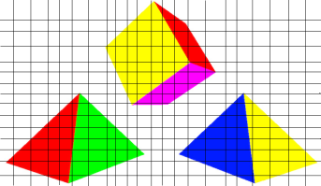
Architectures – GPU
VS
FS
Inmediate Mode Rendering (IMR)
Geometry is processed in submission order
High overdraw (shaded pixels can be overwritten)
Buffers are kept in System Memory
High bandwidth / power / latency
Early-Z helps depending on geometry sorting
Depth buffer value closer than fragment → discard
http://blog.imgtec.com/powervr/understanding-powervr-series5xt-powervr-tbdr-and-architecture-efficiency-part-4
Notes:
IMR / TBR / TBDR
http://blog.imgtec.com/powervr/understanding-powervr-series5xt-powervr-tbdr-and-architecture-efficiency-part-4
http://wenku.baidu.com/view/85ea8fec998fcc22bcd10dcb.html

Slide 16
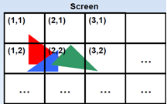
Architectures – GPU
Tile Based Rendering (TBR)
Rasterizing per-tile (triangles in bins per tile) 16x16, 32x32
Buffers are kept on-chip memory (GPU) – fast! → geometry limit?
Triangles processed in submission order (TB-IMR)
Overdraw (front-to-back -> early z cull)
Early-Z helps depending on geometry sorting
http://blog.imgtec.com/powervr/understanding-powervr-series5xt-powervr-tbdr-and-architecture-efficiency-part-4

Slide 17
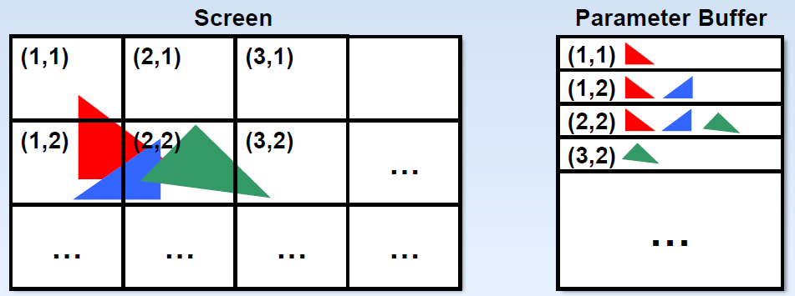
Architectures – GPU
Tile Based Deferred Rendering (TBDR)
Fragment processing (tex + shade) ~waits for Hidden Surface Removal
Micro Depth Buffer – depth test before fragment submission
whole tile → 1 frag/pixel ☺
iPAD 2X slower than Desktop GeForce at HSR (FastMobileShaders_siggraph2011)
Possible to prefetch textures before shading/texturing
Hard to profile!!! ~~~Timing?
Limit: ~100Ktri + complex shader
http://blog.imgtec.com/powervr/understanding-powervr-series5xt-powervr-tbdr-and-architecture-efficiency-part-4
Notes:
http://www.anandtech.com/show/735/3
Rather than process one polygon at a time without knowledge of other polygons in the scene, a tile based renderer first groups polygons together in groups called display lists. These display lists allow a scene to be broken into smaller blocks, known as tiles, which are then rendered independently.
The first advantage to rendering smaller portions of a scene at once is that it allows operations to be performed on-chip without having to access external memory. This allows all z-calculations to be performed without having to access an external z-buffer via the memory bus. Naturally, this eliminates the expensive z-buffer reads and writes that occur constantly on immediate mode renderers.
Rendering small tiles instead of a complete scene also means that pixels that are not visible can be thrown out before the rendering process beings. Since each tile consists of a display list that includes each polygon in that tile, hidden surface removal can occur before any textures are applied. Once again this significantly reduces the amount of information that must travel over the memory bus, as textures for non-visible surfaces do not need to be processed. Also located on chip is a tile buffer which acts as a fame buffer for an individual tile. This allows blending to be performed without costly memory reads and writ

Slide 18
Data/texture compression
ARM’s Adaptive Scalable Texture Compression (ASTC) supported by most mobile GPU vendors
ETC2/EAC standard compression OpenGL ES 3.0
Compression hardware also present in display hardware
Rendered images stored and transferred to the display in a compressed
Saving bandwidth

Slide 19
Other optimizations
Deferred shading
Primitive elimination
Skipping updates to pixels that do not change
ARM memory transaction elimination
Notes:
IMR / TBR / TBDR
http://blog.imgtec.com/powervr/understanding-powervr-series5xt-powervr-tbdr-and-architecture-efficiency-part-4
http://wenku.baidu.com/view/85ea8fec998fcc22bcd10dcb.html

Slide 20
Trends
Specific hardware for ray tracing
Learning libraries & hardware (e.g. Qualcomm’s Fast CV, Nvidia’s CUDA Deep Neural Network)
Skipping updates to pixels that do not change
ARM memory transaction elimination
Notes:
IMR / TBR / TBDR
http://blog.imgtec.com/powervr/understanding-powervr-series5xt-powervr-tbdr-and-architecture-efficiency-part-4
http://wenku.baidu.com/view/85ea8fec998fcc22bcd10dcb.html

Slide 21
Applications

Slide 22
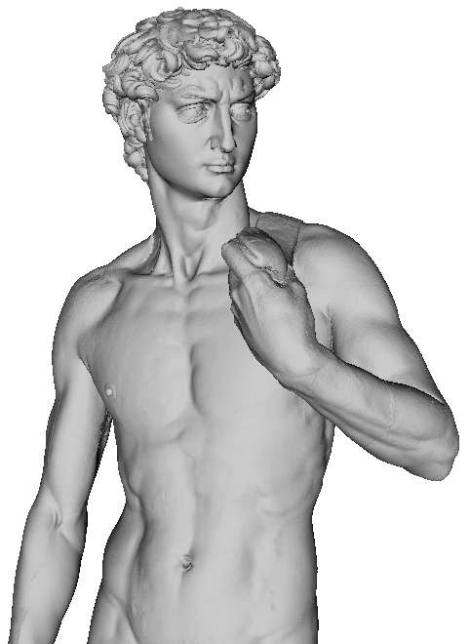
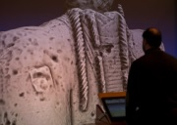
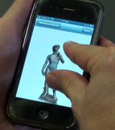
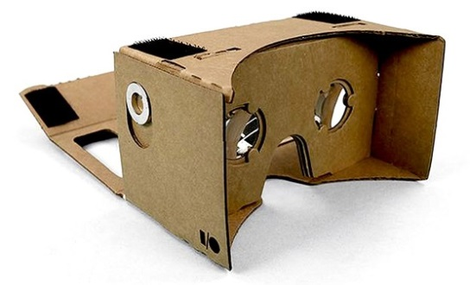
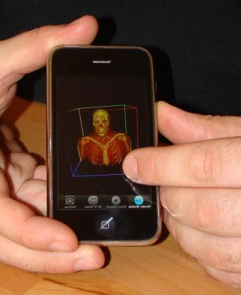
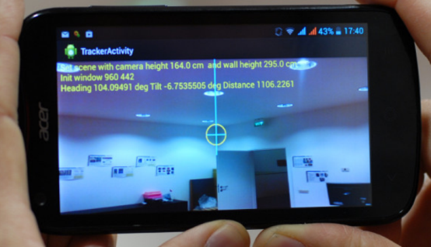
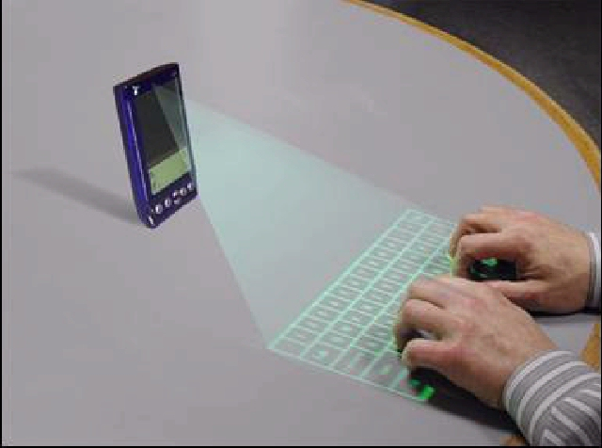
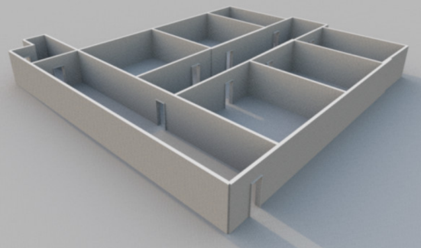
Applications
Wide range of applications
Cultural Heritage
Medical Image
3D object registration
GIS
Gaming
VR & AR
Building reconstruction
Virtual HCI
3D representation
+ additional information

Slide 23
Mobile 3D interactive graphics
General pipeline similar to standard interactive applications
DISPLAY
Frame
DATA
ACCESS
RENDERING
Scene
INTERACTION

Slide 24
Remote rendering
General solution since first PDAs
MOBILE DEVICE
DISPLAY
SERVER
Frame
DATA
ACCESS
RENDERING
Scene
INTERACTION
NETWORK

Slide 25
Remote rendering
3D graphics applications require intensive computation and network bandwidth
electronic games
visualization of very complex 3D scenes
Remote rendering has long history and it is successfully applied for gaming services
Limitation: interaction latency in cellular networks

Slide 26
Mixed Mobile/Remote rendering
As mobile GPUs progress...
MOBILE DEVICE
DISPLAY
SERVER
Frame
DATA
ACCESS
RENDERING
Scene
INTERACTION
NETWORK

Slide 27
Mixed Mobile/Remote rendering
Model based versus Image based methods
Model based methods
Original models
Partial models
Simplified models
Couple of lines
Point clouds
Eisert and Fechteler. Low delay streaming of computer graphics (ICIP 2008)
Gobbetti et al. Adaptive Quad Patches: an Adaptive Regular Structure for Web Distribution and Adaptive Rendering of 3D Models. (Web3D 2012)
Balsa et al.,. Compression-domain Seamless Multiresolution Visualization of Gigantic Meshes on Mobile Devices (Web3D 2013)
Diepstraten et al., 2004. Remote Line Rendering for Mobile Devices (CGI 2004)
Duguet and Drettakis. Flexible point-based rendering on mobile devices (IEEE Trans. on CG & Appl, 2004)

Slide 28
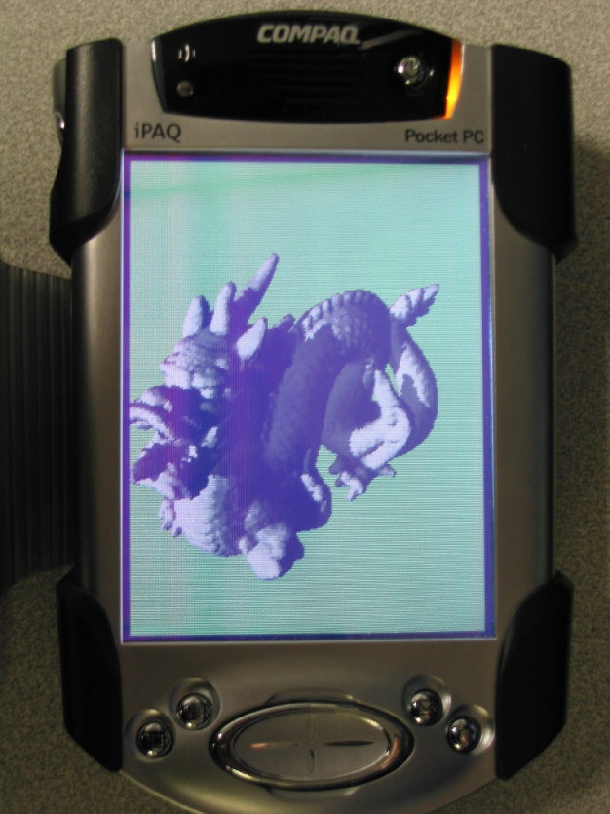
Mixed Mobile/Remote rendering
Model based versus Image based methods
Model based methods
Original models
Partial models
Simplified models
Couple of lines
Point clouds
Eisert and Fechteler. Low delay streaming of computer graphics (ICIP 2008)
Point clouds organized as hierarchical grids.
Tested on PDAs
Gobbetti et al. Adaptive Quad Patches: an Adaptive Regular Structure for Web Distribution and Adaptive Rendering of 3D Models. (Web3D 2012)
Balsa et al.,. Compression-domain Seamless Multiresolution Visualization of Gigantic Meshes on Mobile Devices (Web3D 2013)
Diepstraten et al., 2004. Remote Line Rendering for Mobile Devices (CGI 2004)
Duguet and Drettakis. Flexible point-based rendering on mobile devices (IEEE Trans. on CG & Appl, 2004)

Slide 29
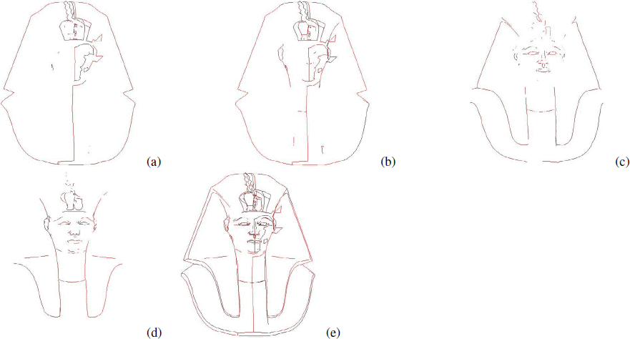
Mixed Mobile/Remote rendering
Model based versus Image based methods
Model based methods
Original models
Partial models
Simplified models
Couple of lines
Point clouds
Eisert and Fechteler. Low delay streaming of computer graphics (ICIP 2008)
Transfer couple of 2D line primitives over the network, which are rendered locally by the mobile device
Gobbetti et al. Adaptive Quad Patches: an Adaptive Regular Structure for Web Distribution and Adaptive Rendering of 3D Models. (Web3D 2012)
Balsa et al.,. Compression-domain Seamless Multiresolution Visualization of Gigantic Meshes on Mobile Devices (Web3D 2013)
Diepstraten et al., 2004. Remote Line Rendering for Mobile Devices (CGI 2004)
Duguet and Drettakis. Flexible point-based rendering on mobile devices (IEEE Trans. on CG & Appl, 2004)

Slide 30
Mixed Mobile/Remote rendering
Model based versus Image based methods
Model based methods
Original models
Partial models
Simplified models
Couple of lines
Point clouds
Eisert and Fechteler. Low delay streaming of computer graphics (ICIP 2008)
Gobbetti et al. Adaptive Quad Patches: an Adaptive Regular Structure for Web Distribution and Adaptive Rendering of 3D Models. (Web3D 2012)
Balsa et al.,. Compression-domain Seamless Multiresolution Visualization of Gigantic Meshes on Mobile Devices (Web3D 2013)
Diepstraten et al., 2004. Remote Line Rendering for Mobile Devices (CGI 2004)
Intercept and stream OpenGL commands
Better performances with respect to video streaming
Limitation: clients need powerful GPU
Duguet and Drettakis. Flexible point-based rendering on mobile devices (IEEE Trans. on CG & Appl, 2004)

Slide 31
Mixed Mobile/Remote rendering
Model based versus Image based methods
Model based methods
Original models
Partial models
Simplified models
Couple of lines
Point clouds
Eisert and Fechteler. Low delay streaming of computer graphics (ICIP 2008)
Gobbetti et al. Adaptive Quad Patches: an Adaptive Regular Structure for Web Distribution and Adaptive Rendering of 3D Models. (Web3D 2012)
Balsa et al.,. Compression-domain Seamless Multiresolution Visualization of Gigantic Meshes on Mobile Devices (Web3D 2013)
Diepstraten et al., 2004. Remote Line Rendering for Mobile Devices (CGI 2004)
More details in Part 5
Duguet and Drettakis. Flexible point-based rendering on mobile devices (IEEE Trans. on CG & Appl, 2004)

Slide 32
Mixed Mobile/Remote rendering
Image based methods
Image impostors
Environment maps
Depth images
Noimark and Cohen-Or. Streaming scenes to mpeg-4 video-enabled devices (IEEE, CG&A 2003)
Lamberti and Sanna. A streaming-based solution for remote visualization of 3D graphics on mobile devices (IEEE, Trans. VCG, 2007)
Bouquerche and Pazzi. Remote rendering and streaming of progressive panoramas for mobile devices (ACM Multimedia 2006)
Zhu et al. Towards peer-assisted rendering in networked virtual environments (ACM Multimedia 2011)
Shi et al. A Real-Time Remote Rendering System for Interactive Mobile Graphics
(ACM Trans. On Multimedia, 2012)
Doellner et al. Server-based rendering of large 3D scenes for mobile devices using G-buffer cube maps ( ACM Web3D, 2012)

Slide 33
Mixed Mobile/Remote rendering
Image based methods
Image impostors
Environment maps
Depth images
Noimark and Cohen-Or. Streaming scenes to mpeg-4 video-enabled devices (IEEE, CG&A 2003)
Lamberti and Sanna. A streaming-based solution for remote visualization of 3D graphics on mobile devices (IEEE, Trans. VCG, 2007)
Image representations are created by the server,
and warped in real time by the client to account for user interaction
Bouquerche and Pazzi. Remote rendering and streaming of progressive panoramas for mobile devices (ACM Multimedia 2006)
Zhu et al. Towards peer-assisted rendering in networked virtual environments (ACM Multimedia 2011)
Shi et al. A Real-Time Remote Rendering System for Interactive Mobile Graphics
(ACM Trans. On Multimedia, 2012)
Doellner et al. Server-based rendering of large 3D scenes for mobile devices using G-buffer cube maps ( ACM Web3D, 2012)

Slide 34
Mixed Mobile/Remote rendering
Model based vs Image based methods
Constraints: rendering quality, bandwidth, interactivity
Model based
Image based
Partial models
Depth images
Image impostors
Original models
Simplified models
Environment maps
Network bandwidth
Client computation
Occlusion warping limitations
Rendering quality

Slide 35
Mobile visualization systems
Volume rendering
Point cloud rendering
Moser and Weiskopf. Interactive volume rendering on mobile devices. Vision, Modeling, and Visualization VMV. Vol. 8. 2008.
Noguerat al. Volume Rendering Strategies on Mobile Devices. GRAPP/IVAPP. 2012.
Campoalegre, Brunet, and Navazo. Interactive visualization of medical volume models in mobile devices. Personal and ubiquitous computing 17.7 (2013): 1503-1514.
Rodríguez, Marcos Balsa, and Pere Pau Vázquez Alcocer. Practical Volume Rendering in Mobile Devices. Advances in Visual Computing. Springer, 2012. 708-718.
Balsa et al. Interactive exploration of gigantic point clouds on mobile devices. ( VAST 2012)
He et al. A multiresolution object space point-based rendering approach for mobile devices (AFRIGRAPH, 2007)

Slide 36
Mobile visualization systems
Volume rendering
Point cloud rendering
Moser and Weiskopf. Interactive volume rendering on mobile devices. Vision, Modeling, and Visualization VMV. Vol. 8. 2008.
Noguerat al. Volume Rendering Strategies on Mobile Devices. GRAPP/IVAPP. 2012.
see section 5 for details
Campoalegre, Brunet, and Navazo. Interactive visualization of medical volume models in mobile devices. Personal and ubiquitous computing 17.7 (2013): 1503-1514.
Rodríguez, Marcos Balsa, and Pere Pau Vázquez Alcocer. Practical Volume Rendering in Mobile Devices. Advances in Visual Computing. Springer, 2012. 708-718.
Balsa et al. Interactive exploration of gigantic point clouds on mobile devices. ( VAST 2012)
He et al. A multiresolution object space point-based rendering approach for mobile devices (AFRIGRAPH, 2007)

Slide 37
Mobile rendering
Nowadays...
MOBILE DEVICE
DISPLAY
Frame
DATA
ACCESS
RENDERING
Scene
INTERACTION

Slide 38
Mobile rendering
Or better...
MOBILE DEVICE
SERVER
DISPLAY
Frame
DATA
ACCESS
RENDERING
Scene
INTERACTION
NETWORK

Slide 39
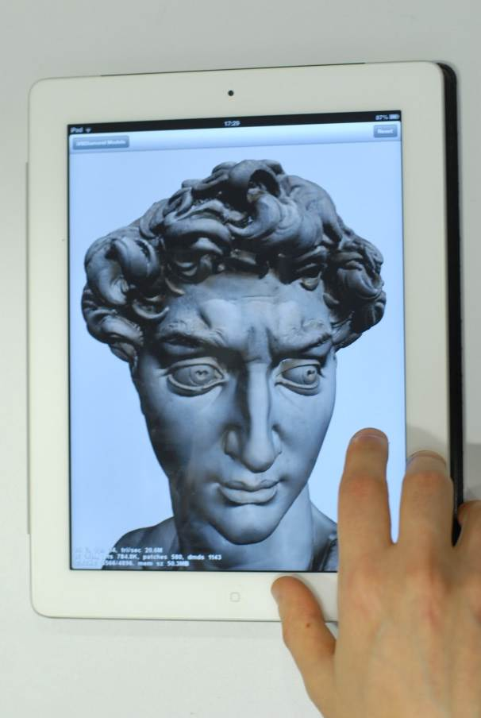
Mobile rendering
Or better...
MOBILE DEVICE
SERVER
DISPLAY
Chunk-based data streaming
(like HuMoRS Balsa et al. 2014)
Limitations: bandwidth consumption (for now)
Frame
DATA
ACCESS
RENDERING
Scene
INTERACTION
NETWORK

Slide 40
Mobile rendering with capture
Exploiting mobile device sensors...
MOBILE DEVICE
Environment
CAPTURE
DISPLAY
Frame
DATA
ACCESS
RENDERING
Scene
INTERACTION

Slide 41
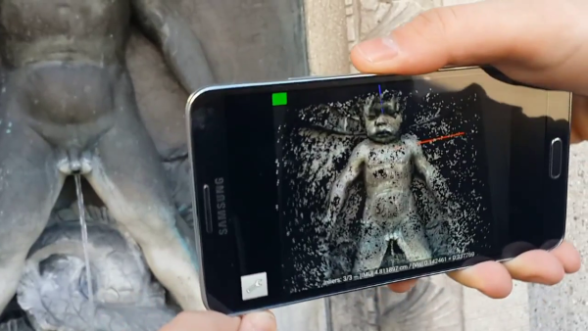
Mobile rendering with capture
Exploiting mobile device sensors...
MOBILE DEVICE
Environment
CAPTURE
DISPLAY
3D scanning with mobile phone
Kolev et al, CVPR 2014
ETH Zurich
Frame
DATA
ACCESS
RENDERING
Scene
INTERACTION
Kolev et al. Turning Mobile Phones into 3D Scanners (CVPR 2014)
Tanskanen et al. Live Metric 3D Reconstruction on Mobile Phones (ICCV 2013)

Slide 42
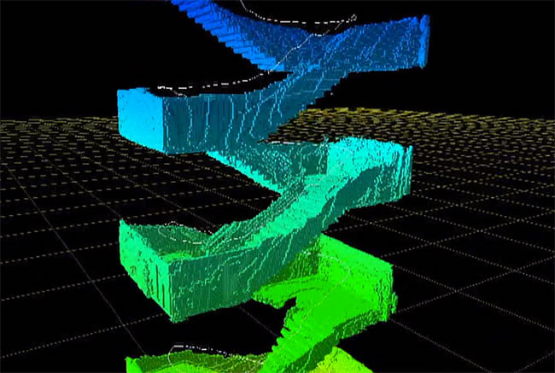
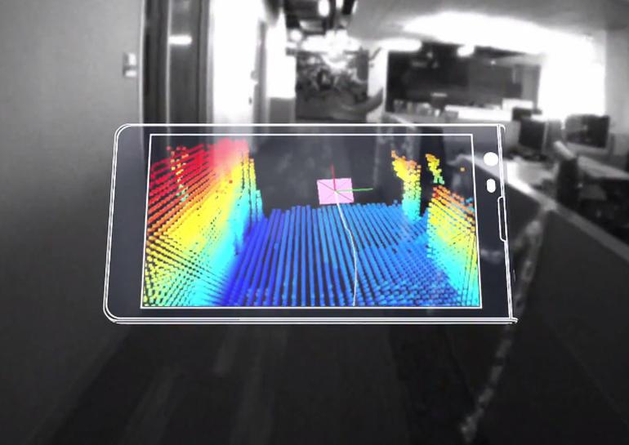
Mobile rendering with capture
Exploiting mobile device sensors...
MOBILE DEVICE
Environment
CAPTURE
DISPLAY
Example:
Google Tango
https://www.google.com/atap/projecttango/#project
Frame
DATA
ACCESS
RENDERING
Scene
INTERACTION

Slide 43
Mobile rendering with capture
Exploiting mobile device sensors...
MOBILE DEVICE
Environment
CAPTURE
DISPLAY
see section 4 for more
applications of sensor integration
Frame
DATA
ACCESS
RENDERING
Scene
INTERACTION

Slide 44
Trends in mobile graphics
Hardware acceleration for improving frame rates, resolutions and rendering quality
Parallel pipelines
Real-time ray tracing
Multi-rate approaches

Slide 45
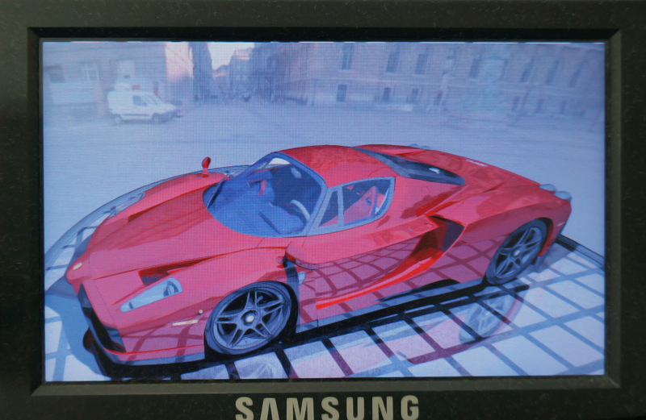
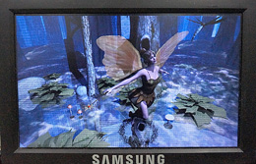
SGRT: Real-time ray tracing
Samsung reconfigurable GPU based on Ray Tracing
Main key features:
an area-efficient parallel pipelined traversal unit
flexible and high-performance kernels for shading and ray generation
Shin et al., Full-stream architecture for ray tracing with efficient data transmission, 2014 IEEE ISCAS
Lee, Won-Jong, et al. SGRT: A mobile GPU architecture for real-time ray tracing. Proceedings of the 5th High-Performance Graphics Conference, 2013.

Slide 46
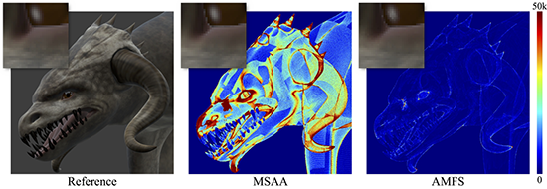
Adaptive shading
Triangles rasterized into coarse fragments that correspond to multiple pixels of coverage
Coarse fragments are shaded, then partitioned into fine fragments for subsequent per-pixel shading
He et al. Extending the graphics pipeline with adaptive, multi-rate shading. ACM Transactions on Graphics (TOG) 33.4 , 2014.
Clarberg, Petrik, et al. AMFS: adaptive multi-frequency shading for future graphics processors. ACM Transactions on Graphics (TOG) 33.4 , 2014.
Won-Jong Lee, et al. Adaptive multi-rate ray sampling on mobile ray tracing GPU. In SIGGRAPH ASIA 2016 Mobile Graphics and Interactive Applications (SA '16).

Slide 47
Mobile rendering with capture
Exploiting mobile device sensors...
MOBILE DEVICE
Environment
CAPTURE
DISPLAY
Frame
DATA
ACCESS
RENDERING
Scene
INTERACTION

Slide 48
Examples: Physical simulations
Framework for physically and chemically-based simulations of analog alternative photographic processes
Efficient fluid simulation and manual process running on iPad
Echevarria et al. Computational simulation of alternative photographic processes. Computer Graphics Forum. Vol. 32. 2013.

Slide 49
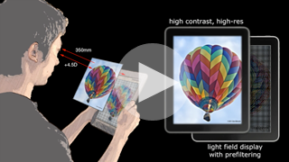
Examples: Correcting visual aberrations
Computational display technology that predistorts the presented content for an observer, so that the target image is perceived without the need for eyewear
Demonstrated in low-cost prototype mobile devices
Huang, Fu-Chung, et al. Eyeglasses-free display: towards correcting visual aberrations with computational light field displays.ACM Transactions on Graphics (TOG) 33.4, 2014.

Slide 50
Conclusions
Heterogeneous applications
driven by bandwidth and processing power
Trends
desktop software solutions tend to be ported to the mobile world
gaming
modelling and 3D animation
complex illumination models
Sensor integration open new scenarios
examples: live acquisition, mHealth (using sensors and cameras for tracking and processing signals)

Slide 51
Graphics development for mobile systems
Next Session

