Slide 1
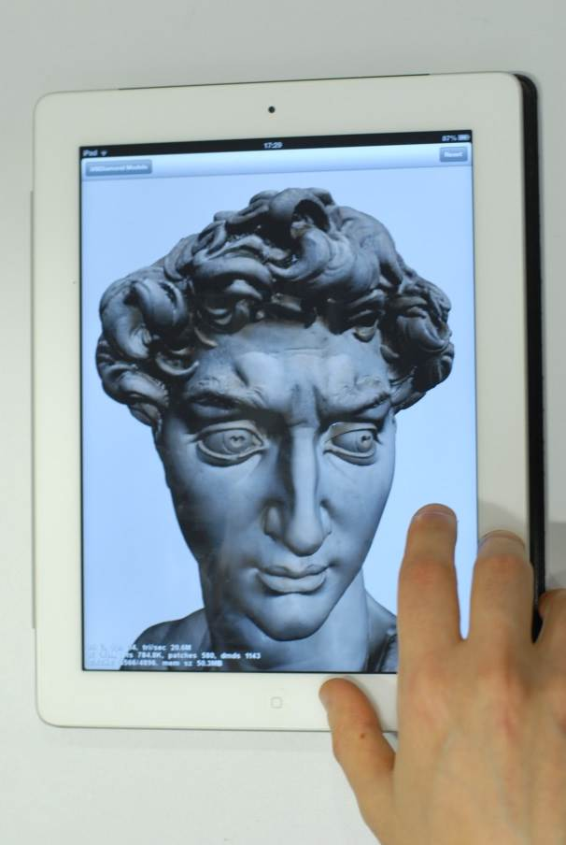
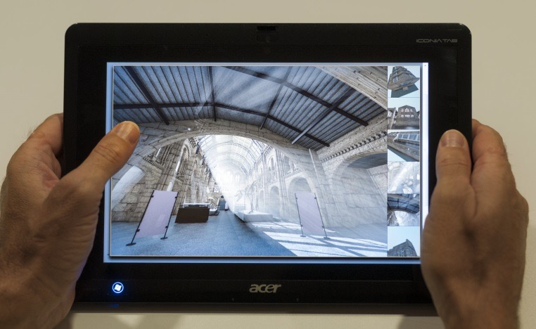
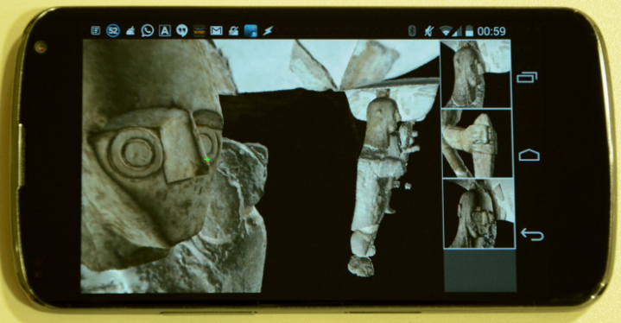
EG 2017 Tutorial 4 Mobile Graphics
Marco Agus, KAUST & CRS4
Enrico Gobbetti, CRS4
Fabio Marton, CRS4
Giovanni Pintore, CRS4
Pere-Pau Vázquez, UPC
April 2017

Slide 2
Welcome to this tutorial!

Slide 3
Subject: Mobile Graphics
All you need to know to get an introduction to the field of mobile graphics:
Scope and definition of “mobile graphics”
Brief overview of current trends in terms of available hardware architectures and research apps built of top of them
Quick overview of development environments
Capture, with focus on data fusion techniques
Rendering, with focus on rendering massive/complex surface and volume models
TUTORIAL NOTES AVAILABLE AT www.crs4.it/vic/eg2017-tutorial-mobile-graphics

Slide 4
Speakers
Marco Agus
Research Engineer at KAUST (Saudi Arabia) and Researcher at CRS4 (Italy)
Enrico Gobbetti
Director of Visual Computing at CRS4 (Italy)
Fabio Marton
Researcher at CRS4
Giovanni Pintore
Researcher at CRS4
Pere-Pau Vázquez
Professor at UPC, Spain

Slide 5
Funding
H2020/Reflective7 - Grant 665091
Projects VIGEC / VIDEOLAB

Slide 6
Schedule
13:30-13:35 | 0. Introduction | Enrico
13:35-13:45 | 1. Evolution of Mobile Graphics | Marco
13.45-14:00 | 2.1 Mobile Graphics Trends / Hardware | Pere-Pau
14.00-14:15 | 2.2 Mobile Graphics Trends / Applications | Marco
14:15-14:40 | 3. Graphics Development for Mobile Systems | Marco
14:40-15:00 | 4. Mobile Metric Capture and Reconstruction | Enrico
15:00-15:30 | BREAK | -
15:30-15:35 | 5.1 Scalable Mobile Visualization / Introduction | Enrico
15:35-15:50 | 5.2 Scalable Mobile Visualization / Massive Meshes | Fabio
15:50-15:55 | 5.3 Scalable Mobile Visualization / Lighting Precomput. | Fabio
15:55-16:10 | 5.4 Scalable Mobile Visualization / Smart Shading | Pere-Pau
16:10-16:25 | 5.5 Scalable Mobile Visualization / Volumes | Pere-Pau
16:25-16:30 | 6. Closing and Q&A | ALL

Slide 7
Evolution of mobile graphics
Next Session

